Slide 1
The network approach to psychopathology: opportunities for an empirically based revision of contemporary classification systems
Eiko Fried
Psychological Methods
University of Amsterdam
www.eiko-fried.com
Twitter @EikoFried
Slides available at www.eiko-fried.com/ABCT2016
ABCT New York City, October 29 2016

Slide 2
Psychiatric nosology
Diagnostic categories do often not meet orthodox criteria for validity
Precise diagnostic boundaries / comorbidity (10.3389/fpsyg.2015.00309)
Lack of biomarkers specificity
(10.3389/fpsyg.2015.00309)
Clear clinical presentation
(10.1016/j.jad.2014.10.010; 10.1007/s12207-014-9186-y)
Notes:
600.000 PTSD; 15.000 MDD.

Slide 3
10.1016/j.jad.2016.10.019
Notes:
Many DSM categories lack a clear clinical presentation. And so many people are very skeptical about the validity of DSM categories.

Slide 4

Summary
Notes:
600.000 PTSD; 15.000 MDD.

Slide 5
Research Domain Criteria
Solution: RDoC that cuts across current diagnostic criteria
D
A
s1
s2
s3
s4
s5
s1
s2
s3
s4
s5

Slide 6
Research Domain Criteria
Solution: RDoC that cuts across current diagnostic criteria
However, similar to the DSM (and other dimensional approaches), RDoC based on assumption that specific symptoms co-occur in syndromes because they share a common cause
?
s1
s2
s3
s4
s5

Slide 7
Research Domain Criteria
“First, the RDoC framework conceptualizes
mental illnesses as brain disorders.”
?
s1
s2
s3
s4
s5

Slide 8

Networks !

Slide 9
Network perspective
Symptoms causally influence each other in complex systems
Not new idea, but we can now estimate networks in models

Slide 10
PTSD
https://osf.io/p69m7/

Slide 11
Substance abuse
10.1016/j.drugalcdep.2016.02.005; D2—withdrawal, D5—monopolizes time
Notes:
Withdrawal — monopolizing time

Slide 12
Bereavement
10.1037/abn0000028

Slide 13
Psychosis
10.1093/schbul/sbw055
Notes:
CHT → psychosis mediated by GPS

Slide 14
Comorbidity
?
D
A
s1
s2
s3
s4
s5
s1
s2
s3
s4
s5
Notes:
“The covariance among mood and anxiety disorders likely represents a shared neurobiological substrate.”
as recognized by many psychopharmacologists.” (Krueger)
Letters to the editors. (2002). Archives of General Psychiatry, 59.

Slide 15
Comorbidity
https://osf.io/6n8cg/
Notes:
(1) It may very well be different for different people with the same comorbid diagnoses, and different for different types of comorbid diagnoses. Aaron.
(2) And if there should really be that certain people are more vulnerable than others for comorbidity, we can generate hypotheses why.

Slide 16
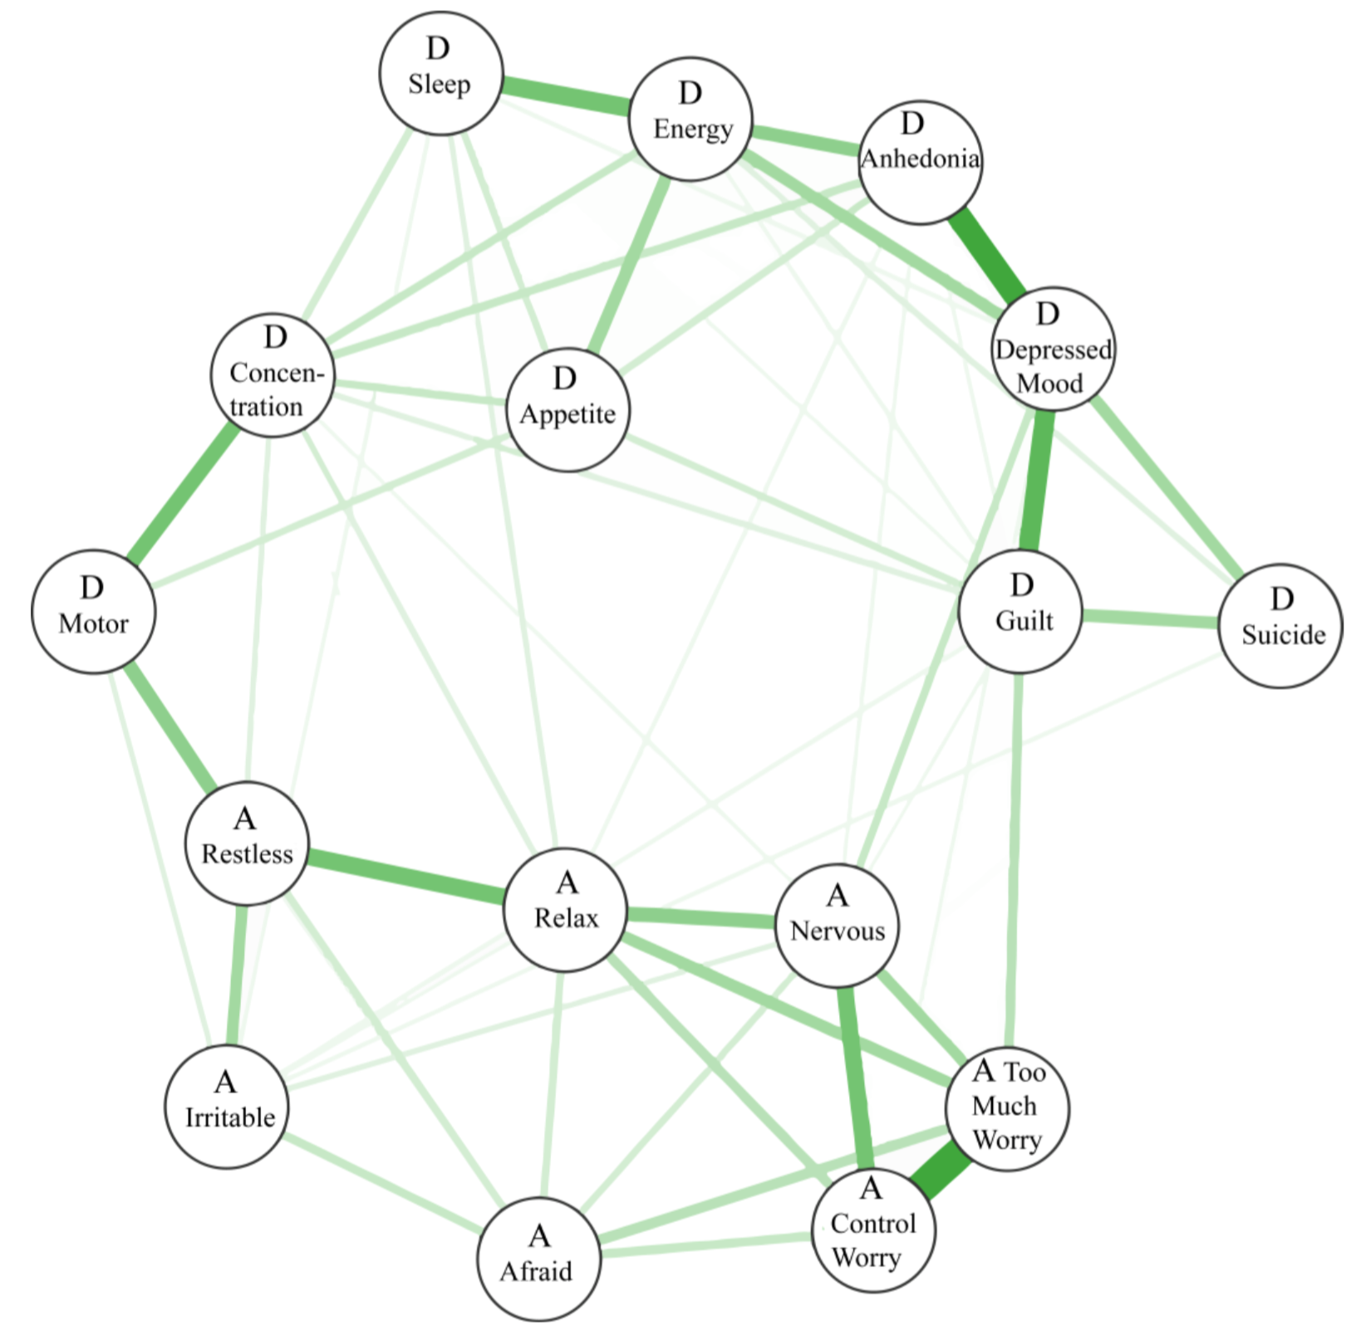
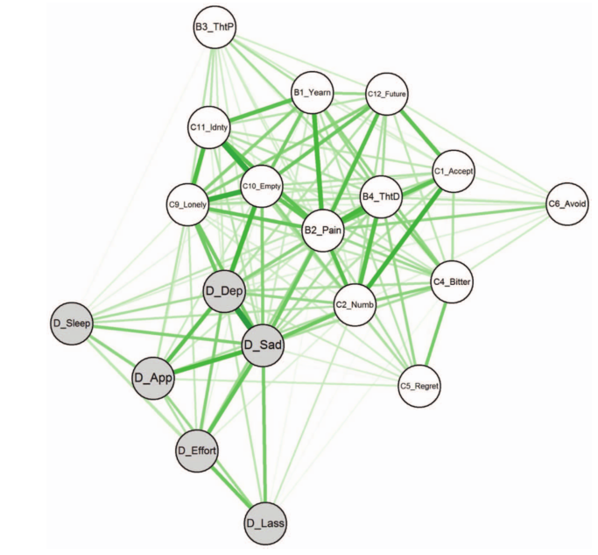
Comorbidity
10.1017/S0033291716002300
10.1037/abn0000002

Slide 17
Centrality
A central symptom is one that exhibits a large number of connections in a network
https://osf.io/6n8cg/

Slide 18
Centrality
10.1016/j.jad.2015.09.005

Slide 19
Centrality

Slide 20
Nosology: bottom-up
http://wp.me/p801LW-4c

Slide 21
Nosology: bottom-up
http://wp.me/p801LW-4c

Slide 22
Nosology: bottom-up
http://wp.me/p801LW-4c

Slide 23
Hybrid models
  Common causes for some sets of symptoms? (https://osf.io/mh3cf/)
  Trauma → PTSD symptoms
  Particular life events → particular depression symptoms
Notes:
There is nothing wrong with structural equation models / factor models, and not all models imply a common cause (e.g., formative models)
But it may be interesting to explore to what degree problems of mental health may be better described as a causal system instead of a common factor

Slide 24
Hybrid models
  Common causes for some sets of symptoms? (https://osf.io/mh3cf/)
  Trauma → PTSD symptoms
  Particular life events → particular depression symptoms
Notes:
There is nothing wrong with structural equation models / factor models, and not all models imply a common cause (e.g., formative models)
But it may be interesting to explore to what degree problems of mental health may be better described as a causal system instead of a common factor

Slide 25
But what about temporal networks Eiko?
Cross-sectional
Time-series

Slide 26
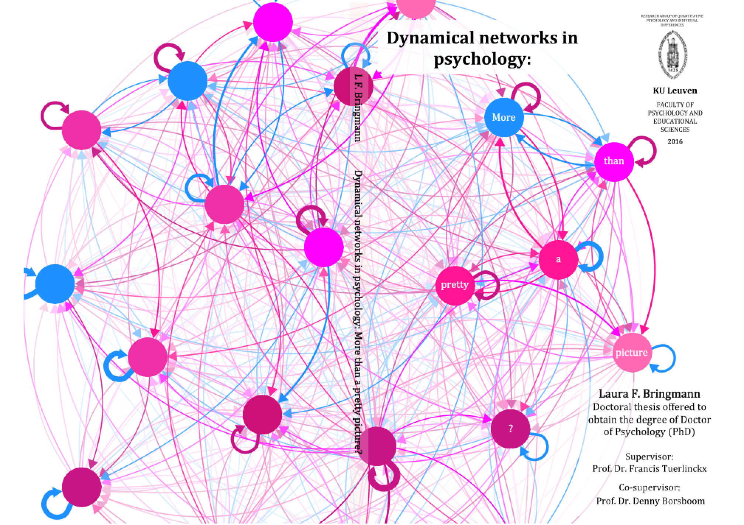
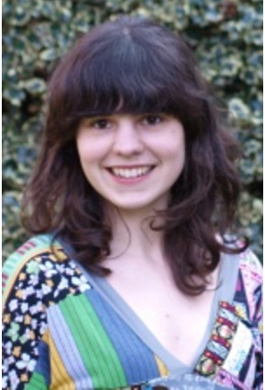
Temporal networks
http://psych-networks.com/wp-content/uploads/2016/10/Thesis_LFBringmann-w-voorkant.pdf

Slide 27

Resources
  “Mental disorders as networks of problems: a review of recent insights”
  (https://osf.io/6n8cg)
  “Moving forward: challenges and directions for psychopathological network theory and methodology”
  (https://osf.io/mh3cf)
  Causality
  Validity of network models
  Statistical robustness of network models
  Heterogeneity
Notes:
RESOURCES:

Slide 28
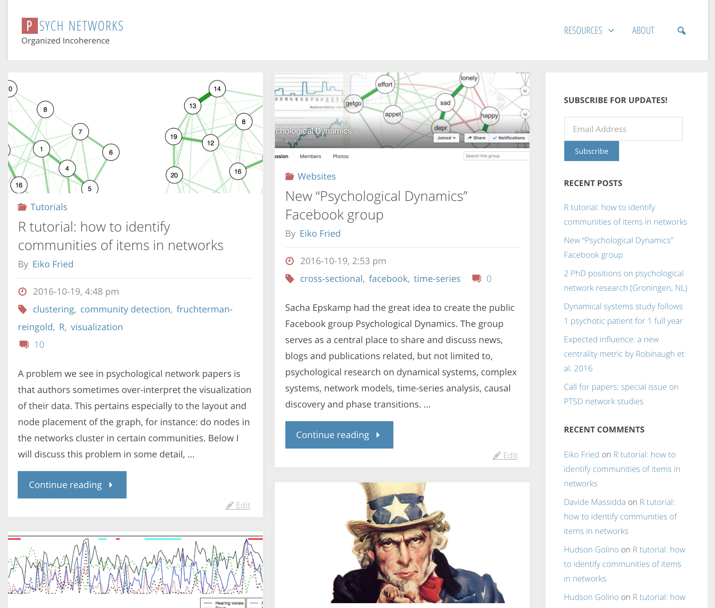
www.psych-networks.com

Slide 29

Fantastic network colleagues & collaborators
Denny Borsboom, Angelique Cramer, Sacha Epskamp, Marie Deserno, Claudia van Borkulo, Lynn Boschloo, Laura Bringmann, Francis Tuerlinckx, Don Robinaugh, Courtney Beard, Jason Elias, Alex Millner, Richard McNally, Ken Kendler, Steven Aggen, Hudson Santos, Cherie Armour, Marieke Wichers, Fionneke Bos.

Slide 30
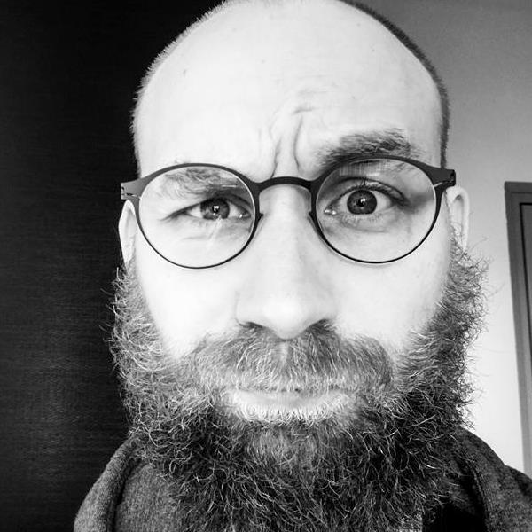
Eiko Fried
www.eiko-fried.com
Twitter @EikoFried
Slides are available at www.eiko-fried.com/ABCT2016
ABCT New York City, October 29 2016

