Slide 1
Common Measurement Problems in Psychology:
The Example of Major Depression
Eiko Fried
Leiden University
The Netherlands
APS 2018
Slides at eiko-fried.com/APS2018

Slide 2
Why should you care
Depression is among the most common and debilitating mental disorders
Depression is among the most commonly measured constructs
  HRSD, BDI & CES-D among top 100 cited papers

Slide 3
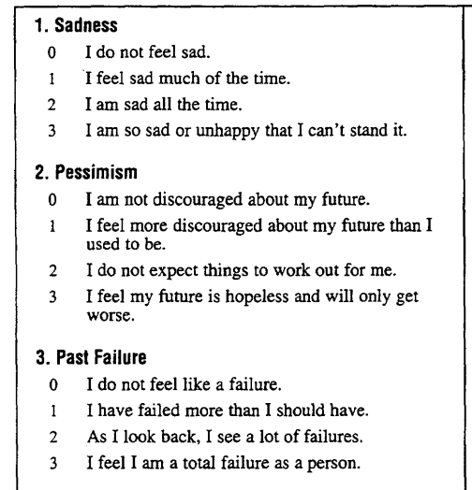
How do we measure depression?
Assess symptoms
Add them to one
sum-score
Use this score in a
statistical model

Slide 5
1. Many measures
280 depression scales developed and used in last century
“The appearance of yet another rating scale for measuring symptoms of depression may seem unnecessary, since there are so many already in existence and many of them have been extensively used.”
— Hamilton, 1960 (~30.000 citations)
DOI | 10.1207/s15366359mea0403_1

Slide 6
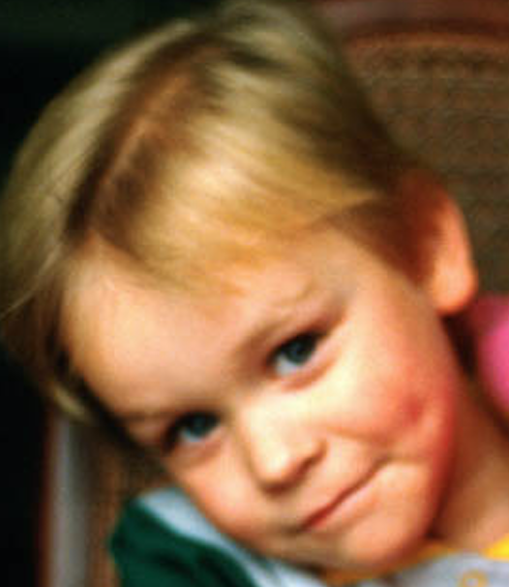
1. Many measures
280 depression scales developed and used in last century
Researchers usually use 1 scale per study, and rarely provide a rationale as to why
They then draw general conclusions about depression
Relies on the assumption that scales are interchangeable
DOI | 10.1207/s15366359mea0403_1
Notes:
This is not necessarily a problem in itself

Slide 7
DOI | 10.1016/j.jad.2016.10.019

Slide 8
40% of all symptoms appear in only 1 scale
Only 12% appear across all instruments
DOI | 10.1016/j.jad.2016.10.019

Slide 9

DOI | 10.1016/j.jad.2016.10.019

Slide 10
1. Many measures
Implications:
There is a fundamental lack of agreement on what depression is and how to measure it
Because researchers usually use 1 scale, and because scales are not interchangeable: considerable threat to replicability and generalizability of depression research

Slide 11
“Eiko, the holy book of psychiatry clearly defines major depression with 9 symptoms. Certainly that settles the issue, right?”
Notes:
Which leads me to the second point

Slide 12

“Eiko, the holy book of psychiatry clearly defines major depression with 9 symptoms. Certainly that settles the issue, right?”

Slide 13
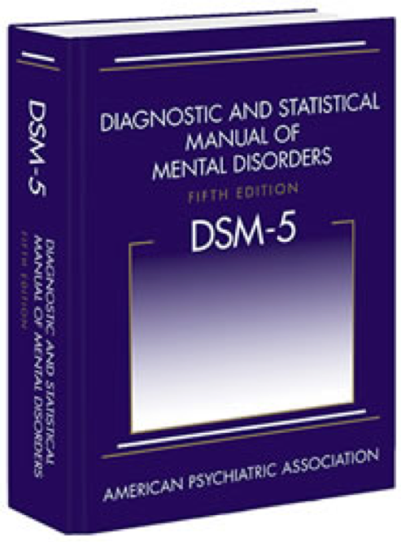
“Eiko, the holy book of psychiatry clearly defines major depression with 9 symptoms. Certainly that settles the issue, right?”

Slide 14
2. DSM
DSM symptoms
  Diminished interest or pleasure
  Depressed mood
  Increase or decrease in either weight or appetite
  Insomnia or hypersomnia
  Psychomotor agitation or retardation
  Fatigue or loss of energy
  Worthlessness or inapproriate guilt
  Problems concentrating or making decisions
  Thoughts of death or suicidal ideation
Notes:
Let’s ignore for this talk that symptoms are weird …

Slide 15
2. DSM
DSM symptoms
  Diminished interest or pleasure
  Depressed mood
  Increase or decrease in either weight or appetite
  Insomnia or hypersomnia
  Psychomotor agitation or retardation
  Fatigue or loss of energy
  Worthlessness or inapproriate guilt
  Problems concentrating or making decisions
  Thoughts of death or suicidal ideation
DOI | 10.1016/j.jad.2014.10.010

Slide 16
2. DSM
DSM symptoms
  Diminished interest or pleasure
  Depressed mood
  Increase or decrease in either weight or appetite
  Insomnia or hypersomnia
  Psychomotor agitation or retardation
  Fatigue or loss of energy
  Worthlessness or inapproriate guilt
  Problems concentrating or making decisions
  Thoughts of death or suicidal ideation
>
>
>
DOI | 10.1016/j.jad.2014.10.010

Slide 17
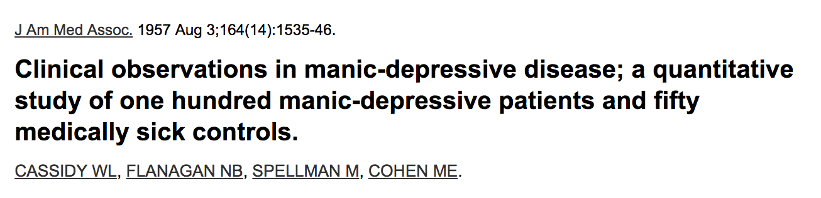
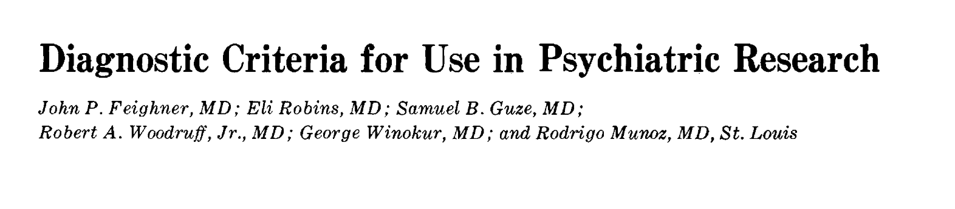
1957: Clinical features of manic-depressive disorders
1972: Slight modifications
1980: DSM-III, minor adaptation
2013: DSM-5, no changes
Notes:
The point is that these symptoms are fairly arbitrary and based on history, not empirical evidence

Slide 18
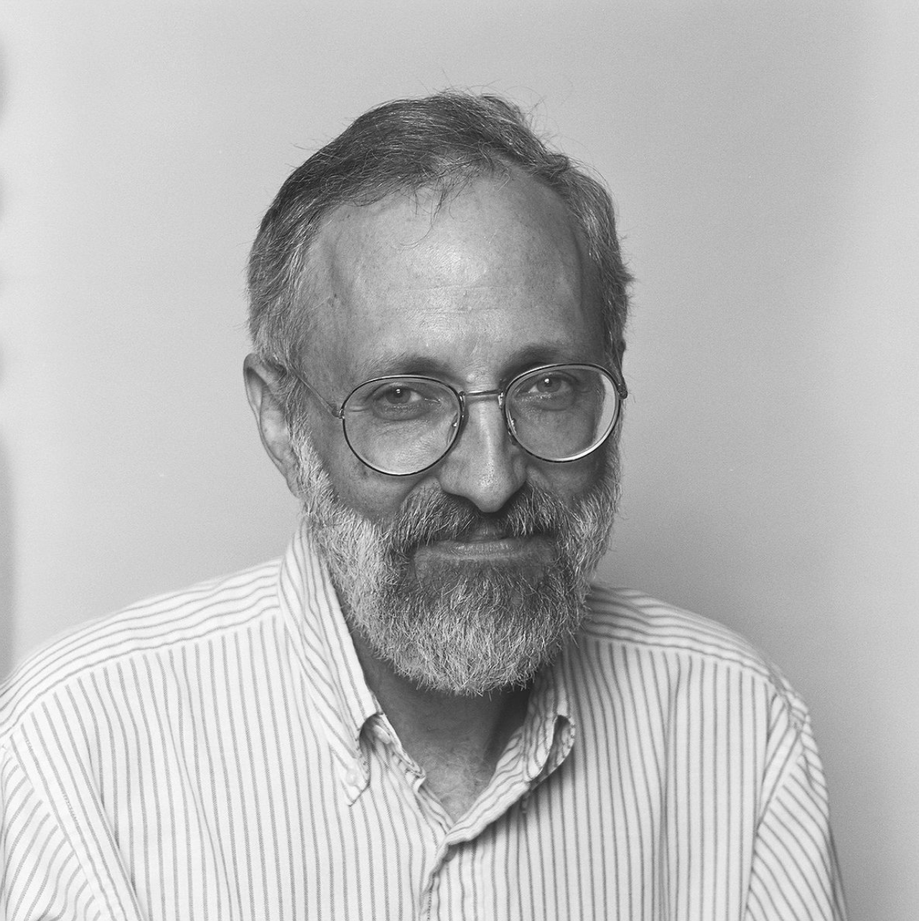
2. DSM
What would have happened if …
Kraepelin could have stayed in Wundt’s laboratory
Wernicke, Kraepelin’s competitor, had not died from a bicycle accident
”One can plausibly argue that the DSM-5 would be meaningfully different from what it is today.”
DOI | 10.1002/wps.20292

Slide 19
3. Scale quality
“Eiko, the DSM is surely an exception: the other depression scales were constructed by psychometricians … right? RIGHT?!?”
Most commonly used depression scales in use today are from papers in 1960, 1961, and 1977
The studies do not meet basic criteria for validation studies, and overall psychometric quality of scales is poor
Scales were not constructed by psychometricians
DOI | 10.1176/appi.ajp.161.12.2163
Notes:
I see you’re getting desperate there ...

Slide 20
3. Scale quality
Lack of unidimensionality
Tens of thousands of papers used one sum-score although the construct that scales aim to measure is multidimensional
DOI | 10.1037/pas0000275
Notes:
Half a century of psychometric research has shown

Slide 21
3. Scale quality
Temporal MI: does a scale assess the same construct(s) over time
Study with:
  4 rating scales (self-report and clinician report)
  In very large samples
  Time frames between 6 weeks and 2 years
Temporal MI violated at the structural level: 3-5 factors in depressed populations, 1-2 factors after treatment
Entire clinical trial literature (half a century) based on scales that lack MI
DOI | 10.1037/pas0000275
Notes:
e.g. epidemiological study or clinical trial.
14 points of Bob before treatment DO NOT MEAN THE SAME THING as after

Slide 22
Depression measurement: a summary

Slide 23


Slide 24
Depression measurement: a summary
Knowledge about depression largely based on studies with one specific scale
Problematic, because dozens of scales exist that differ in content and are at best moderately correlated; issues for replicability / generalizability
Most commonly used scales from 60s/70s; DSM criteria from 50s with slight adaptations; path dependence rather than psychometric evidence
Most scales & DSM criteria lack basic psychometric properties such as unidimensionality or MI
Despite all of that, we use sum-scores as outcome or predictor in nearly all depression research.

Slide 25
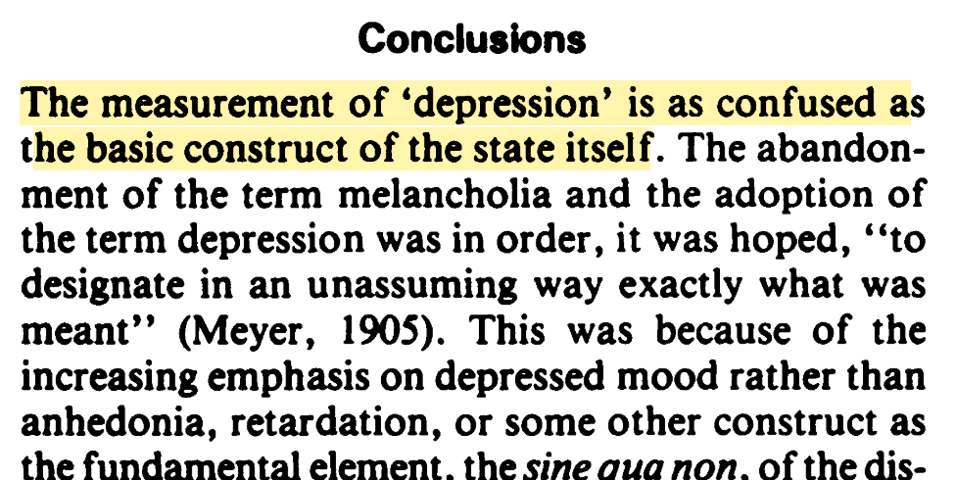
DOI | 10.1192/bjp.163.3.293

Slide 26




Mark Zimmerman Ken Kendler Scott Lilienfeld

Slide 27

Thank you!
APS 2018
Slides at eiko-fried.com/APS2018

