Slide 1
Psychiatric Symptomics: a novel research paradigm to study Major Depression
Eiko Fried
University of Leuven
University of Amsterdam
Amsterdam, February 3rd 2016

Slide 2
Outline
How MDD research is conducted
MDD research is stuck
MDD is stuck due to problematic assumptions
Symptomics offers new opportunities

Slide 3
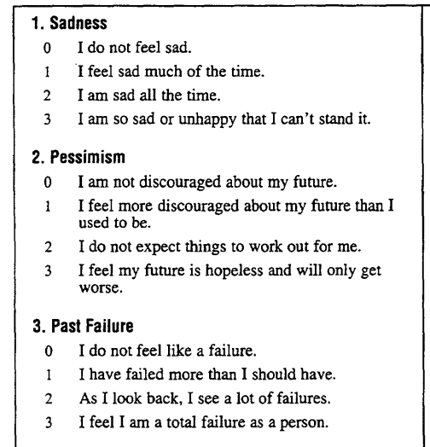
How MDD research is conducted
Depression assessment
  Use specific scale to assess a range of depression symptoms like sad mood, insomnia, fatigue, concentration problems, or suicidal ideation
  Add symptoms up to one sum-score that reflects depression severity

Slide 4
How MDD research is conducted
Depression assessment
  Use specific scale to assess a range of depression symptoms like sad mood, insomnia, fatigue, concentration problems, or suicidal ideation
  Add symptoms up to one sum-score that reflects depression severity
Statistical analysis
  Categorical: use threshold on sum-score to split group into healthy and depressed, compare groups regarding biomarkers, risk factors, etc.
  Dimensional: associate sum-score (depression severity) to biomarkers, risk factors, etc.

Slide 5
How MDD research is conducted
Depression assessment
  Use specific scale to assess a range of depression symptoms like sad mood, insomnia, fatigue, concentration problems, or suicidal ideation
  Add symptoms up to one sum-score that reflects depression severity
Statistical analysis
  Categorical: use threshold on sum-score to split group into healthy and depressed, compare groups regarding biomarkers, risk factors, etc.
  Dimensional: associate sum-score (depression severity) to biomarkers, risk factors, etc.
ID | Severity | Group | Biomarker
1 | 7 | 0 | 20
2 | 14 | 1 | 62
3 | 12 | 1 | 11
4 | 2 | 0 | 37
5 | 5 | 0 | 15
6 | 11 | 1 | 92

Slide 6
How MDD research is conducted
Depression assessment
  Use specific scale to assess a range of depression symptoms like sad mood, insomnia, fatigue, concentration problems, or suicidal ideation
  Add symptoms up to one sum-score that reflects depression severity
Statistical analysis
  Categorical: use threshold on sum-score to split group into healthy and depressed, compare groups regarding biomarkers, risk factors, etc.
  Dimensional: associate sum-score (depression severity) to biomarkers, risk factors, etc.
ID | Severity | Group | Biomarker
1 | 7 | 0 | 20
2 | 14 | 1 | 62
3 | 12 | 1 | 11
4 | 2 | 0 | 37
5 | 5 | 0 | 15
6 | 11 | 1 | 92

Slide 7
How MDD research is conducted
Depression assessment
  Use specific scale to assess a range of depression symptoms like sad mood, insomnia, fatigue, concentration problems, or suicidal ideation
  Add symptoms up to one sum-score that reflects depression severity
Statistical analysis
  Categorical: use threshold on sum-score to split group into healthy and depressed, compare groups regarding biomarkers, risk factors, etc.
  Dimensional: associate sum-score (depression severity) to biomarkers, risk factors, etc.
ID | Severity | Group | Biomarker
1 | 7 | 0 | 20
2 | 14 | 1 | 62
3 | 12 | 1 | 11
4 | 2 | 0 | 37
5 | 5 | 0 | 15
6 | 11 | 1 | 92

Slide 8
How MDD research is conducted
Depression assessment
  Use specific scale to assess a range of depression symptoms like sad mood, insomnia, fatigue, concentration problems, or suicidal ideation
  Add symptoms up to one sum-score that reflects depression severity
Statistical analysis
  Categorical: use threshold on sum-score to split group into healthy and depressed, compare groups regarding biomarkers, risk factors, etc.
  Dimensional: associate sum-score (depression severity) to biomarkers, risk factors, etc.
This describes far over 99% of all MDD research, ranging from social sciences to genetics

Slide 9
Outline
How MDD research is conducted
MDD research is stuck
MDD is stuck due to problematic assumptions
Symptomics offers new opportunities

Slide 10

The problems
Genetics
Neuroimaging
Antidepressants
Diagnosis
Heterogeneity of MDD

Slide 11

1. Genetics

Slide 12
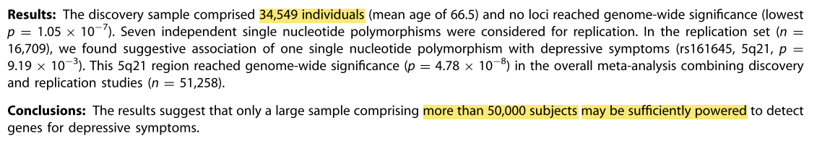

Heritability of MDD is about 0.4 – 0.5
  Sullivan et al. 2009, Molecular Psychiatry
  Lewis et al. 2010, American Journal of Psychiatry
  Shi et al. 2011, Molecular Psychiatry
  Wray et al. 2012, Molecular Psychiatry
  Hek et al. 2013, Biological Psychiatry
  Daly et al., 2013, Molecular Psychiatry
No single loci reached replicated genome-wide significance

Slide 13
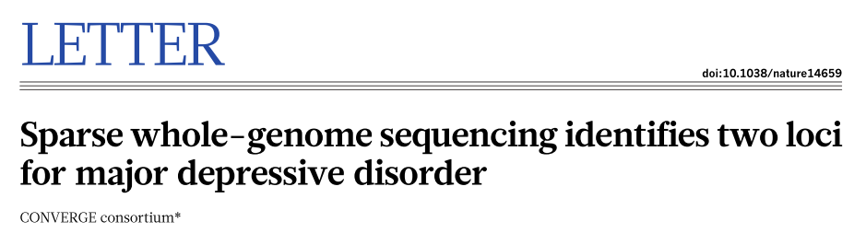
Sample 1: 5k Han-Chinese women with recurrent MD, 5k controls
Sample 2: 5k Han-Chinese women with recurrent MD
Identified and replicated 2 loci contributing to MD risk on chromosome 10
DOI | 10.1038/nature14659

Slide 14
Sample 1: 5k Han-Chinese women with recurrent MD, 5k controls
Sample 2: 5k Han-Chinese women with recurrent MD
Identified and replicated 2 loci contributing to MD risk on chromosome 10
“We attribute our success to the recruitment of relatively homogeneous cases with severe illness.”
DOI | 10.1038/nature14659

Slide 15

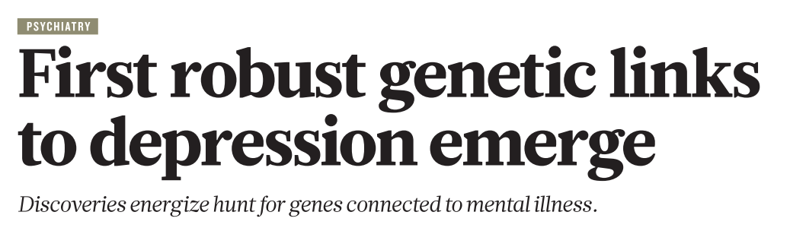

DOI | 10.1038/nature14659

Slide 16
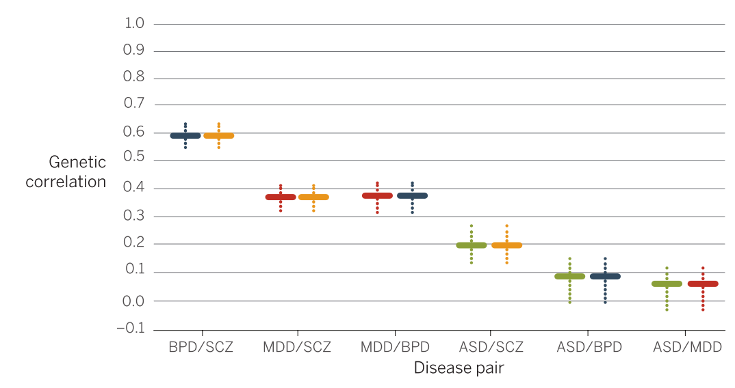
No replication in third sample of European ancestry
Explained variance of 2 loci on depression diagnosis in Han-Chinese samples extremely small; even if replicated, results are clinically useless
Results not specific to MDD (Geschwind & Flint, 2015)
DOI | 10.1126/science.aaa8954
DOI | 10.1038/nature14659

Slide 17
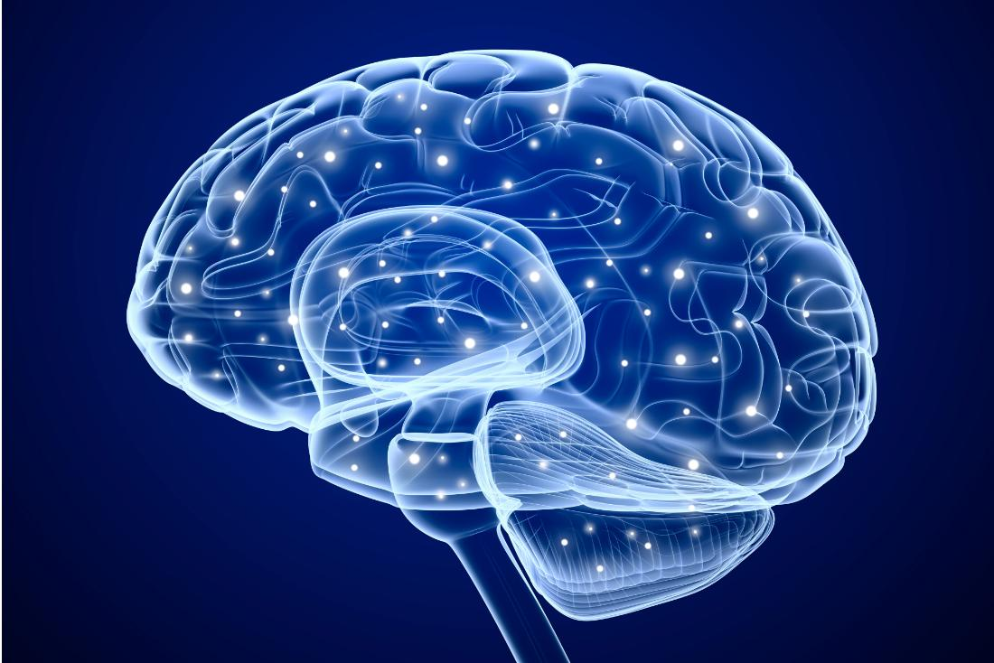
2. Neuroimaging

Slide 18
Prior literature:
small samples, findings in various regions and directions

Slide 19
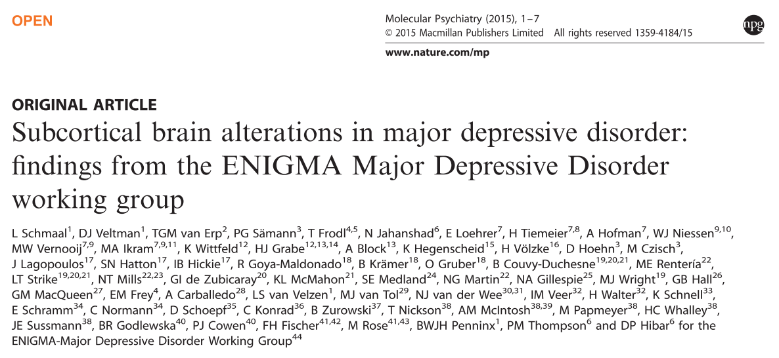
1728 MD patients, 7199 controls; 9 subcortical regions
DOI | 10.1038/mp.2015.69

Slide 20
1728 MD patients, 7199 controls; 9 subcortical regions
Analyses:
  Dimensional: no region associated with MD severity
DOI | 10.1038/mp.2015.69

Slide 21
1728 MD patients, 7199 controls; 9 subcortical regions
Analyses:
  Dimensional: no region associated with MD severity
  Categorical: hippocampal volume smaller in MD patients (1.4% volume difference, Cohen‘s d = 0.17)
DOI | 10.1038/mp.2015.69

Slide 22
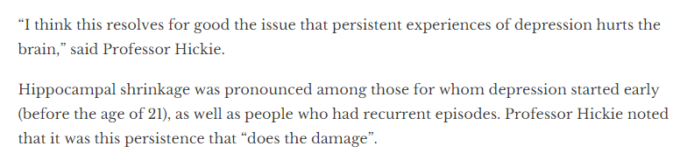
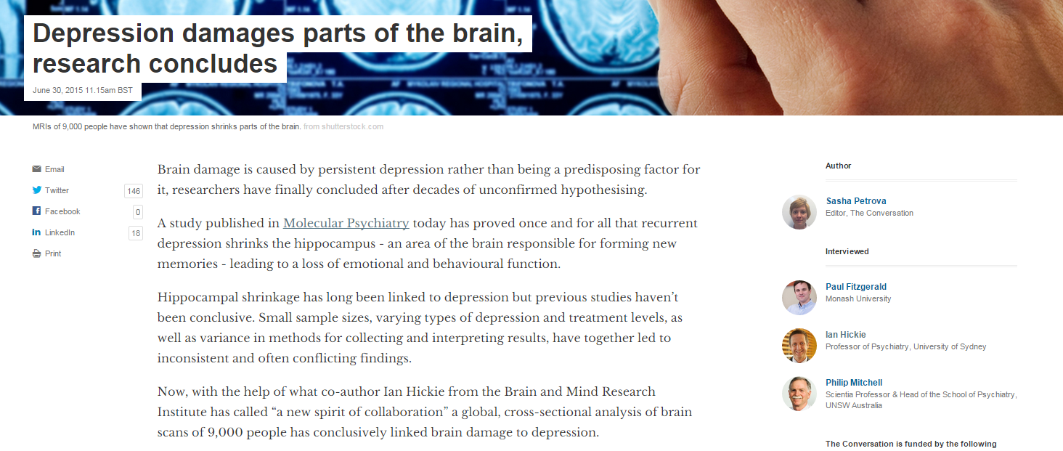
URL | https://theconversation.com/depression-damages-parts-of-the-brain-research-concludes-43915

Slide 23
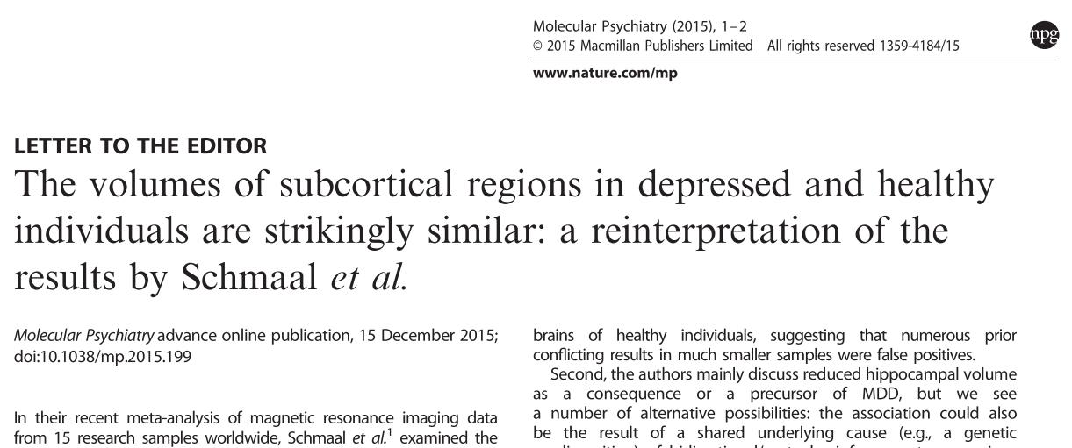
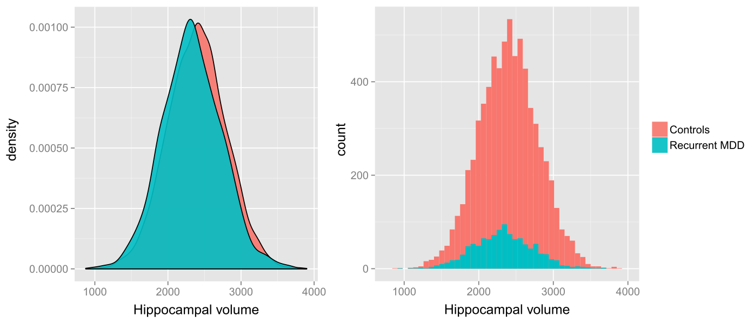
Hippocampal volume smaller in MD patients (1.4% volume difference, Cohen‘s d = 0.17)
Goal of the consortium to "robustly discriminate MDD patients from healthy controls"
Prediction accuracy: 52.6%
DOI | 10.1038/mp.2015.69

Slide 24
Additional caveats:
Finding not specific to MDD: smaller hippocampal volume in schizophrenia, PTSD, chronic alcoholism, epilepsy, Alzheimer's, Huntington's, accelerated aging, lack of exercise and activity, and many other

Slide 25

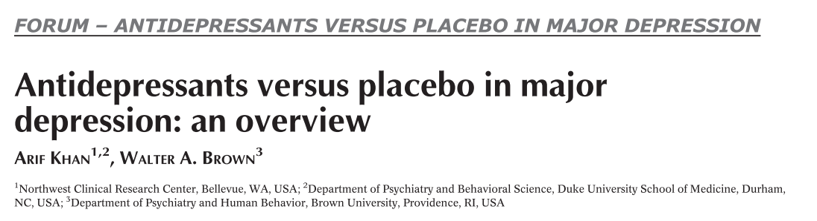
3. Antidepressant efficacy
About 40% of patients respond to antidepressants, whereas 30% respond to placebo
  Pigott 2010 (10.1159/000318293)
  Kirsch 2008 (10.1371/journal.pmed.0050045)
DOI | 10.1002/wps.20241

Slide 26
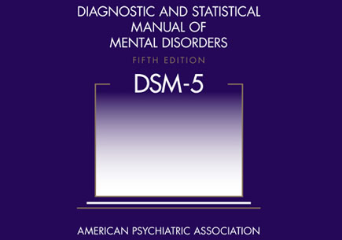
4. Reliability of diagnosis

Slide 27
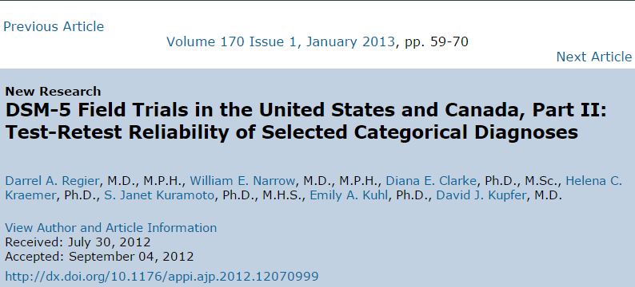
"Questionable" MD inter-rater reliability of 0.28
  For comparison: 0.61 ADHD, 0.54 Borderline
DOI | 10.1176/appi.ajp.2012.12070999

Slide 28
5. Heterogeneity of MDD

Slide 29
Heterogeneity of MDD
DSM-5 diagnosis of depression
  Diminished interest or pleasure
  Depressed mood
  Increase or decrease in either weight or appetite
  Insomnia or hypersomnia
  Psychomotor agitation or retardation
  Fatigue or loss of energy
  Worthlessness or inapproriate guilt
  Problems concentrating or making decisions
  Thoughts of death or suicidal ideation
Notes:
So let's take a more detailed look at the symptoms.
The DSM lists 9 disparate psychiatric criterion symptoms for depression, which is quite a large number for one syndrome.

Slide 30
Heterogeneity of MDD
DSM-5 diagnosis of depression
  Diminished interest or pleasure
  Depressed mood
  Increase or decrease in either weight or appetite
  Insomnia or hypersomnia
  Psychomotor agitation or retardation
  Fatigue or loss of energy
  Worthlessness or inapproriate guilt
  Problems concentrating or making decisions
  Thoughts of death or suicidal ideation
Notes:
On top of that, 8 of these symptoms are actually compound symptoms consisting of several subsymptoms.

Slide 31
Heterogeneity of MDD
DSM-5 diagnosis of depression
  Diminished interest or pleasure
  Depressed mood
  Increase or decrease in either weight or appetite
  Insomnia or hypersomnia
  Psychomotor agitation or retardation
  Fatigue or loss of energy
  Worthlessness or inapproriate guilt
  Problems concentrating or making decisions
  Thoughts of death or suicidal ideation
  Depending on how you count, this allows for a large number of possible combinations. It is possible for patients with the same diagnosis to have no single symptom in common.
>
>
>
Notes:
And three of the symptoms even have contrasting features
A very conservative estimation leads to 1497 unique symptom profiles that all qualify for the same diagnosis.

Slide 32
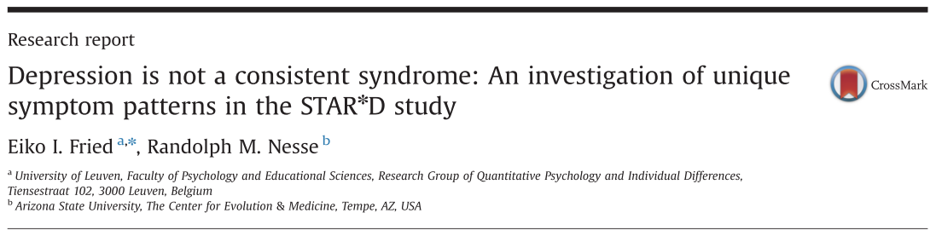
Study on symptom profiles
Study number of unique symptom profiles in 3,703 MD outpatients
Quantify the number of symptom profiles
  1 0 0 0 1 0 1 1 1
DOI | 10.1016/j.jad.2014.10.010
Notes:
Considered highly representative
While cross-sectional, we have causality in here.

Slide 33
Study on symptom profiles
1,030 unique symptom profiles in 3,703 MD outpatients
  3.6 patients per profile
501 profiles (48.6%) were endorsed by only one individual
The most common symptom profile exhibited a frequency of only 1.8%
MDD may be a problematic phenotype for genetic studies, brain studies, a "one size fits all" treatment, etc.
DOI | 10.1016/j.jad.2014.10.010
Notes:
Considered highly representative
While cross-sectional, we have causality in here.

Slide 34
Heterogeneity of MDD, continued
DSM-5 symptoms are based on historical reasons, not psychometric reasons. Current 9 symptoms derived from 11 symptoms written down by Cassidy in 1957; adapted by Feighner in 1972.
280 depression scales in the last century, at least 20 of which are still commonly used
Notes:
Considered highly representative
While cross-sectional, we have causality in here.

Slide 35
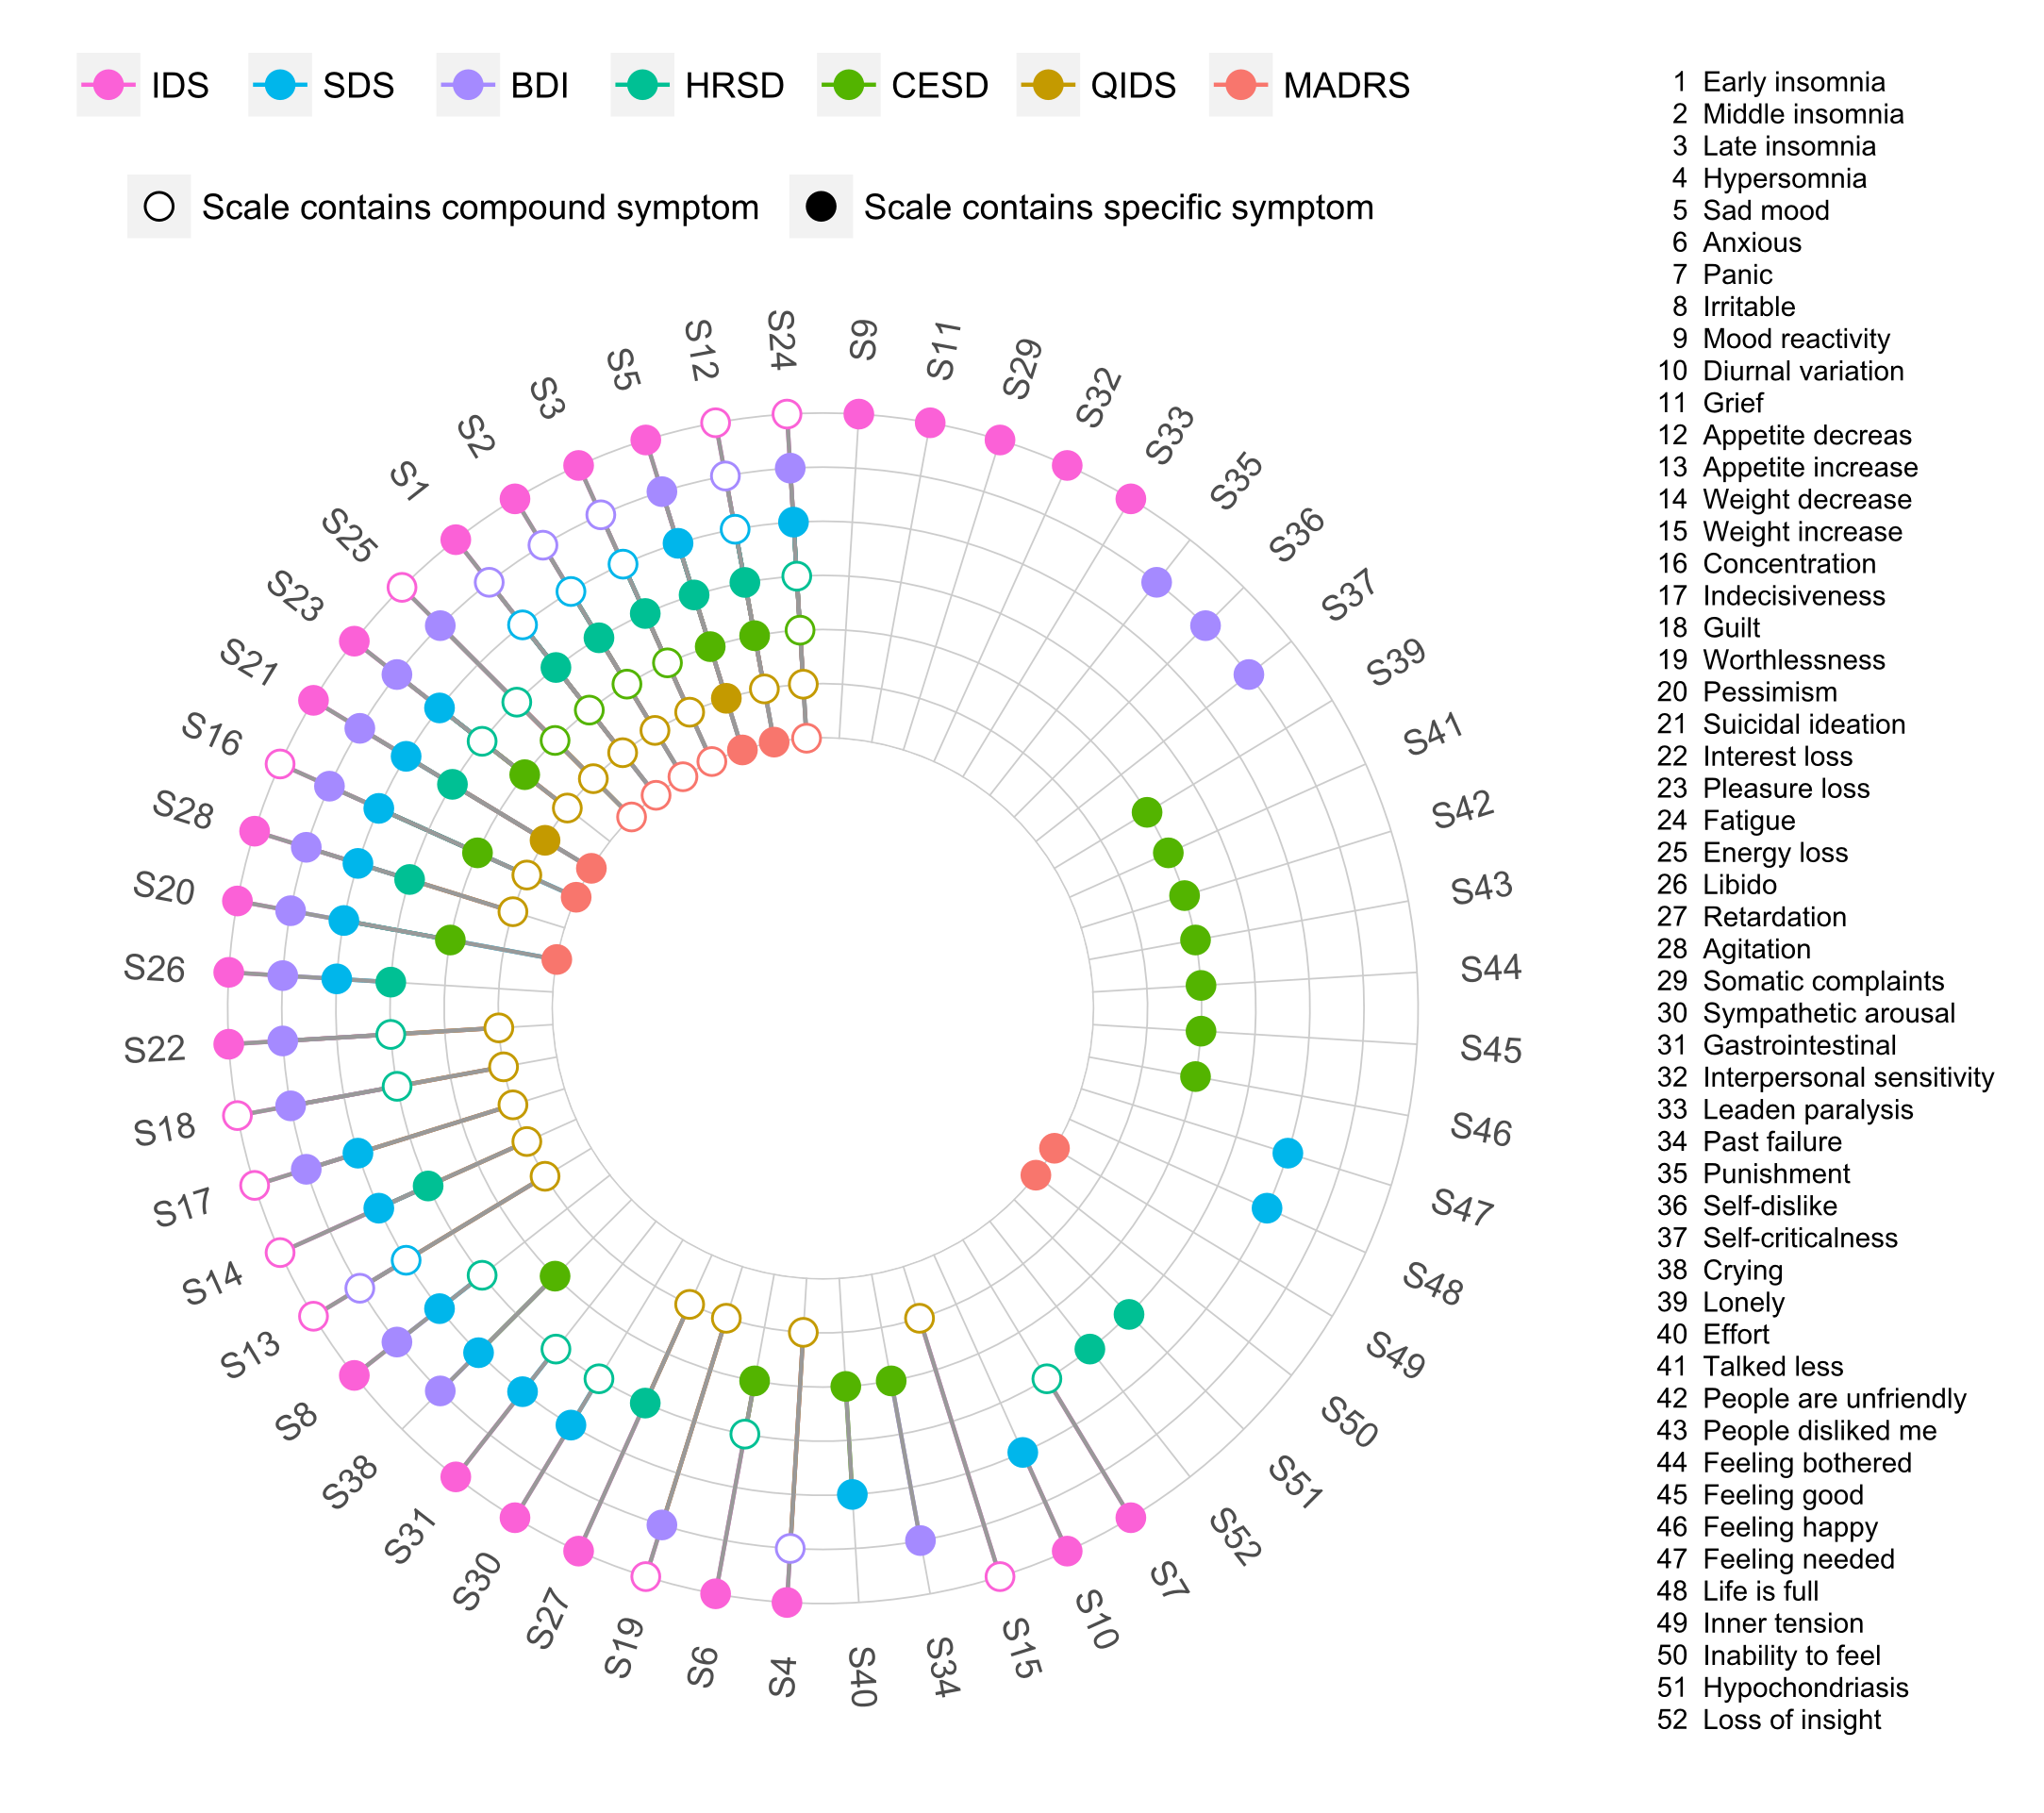
Common scales assess different symptoms
Notes:
10.3389/fpsyg.2015.00309

Slide 36
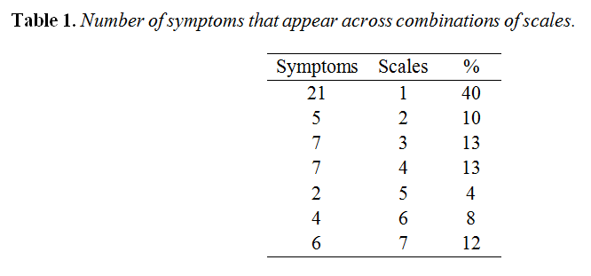
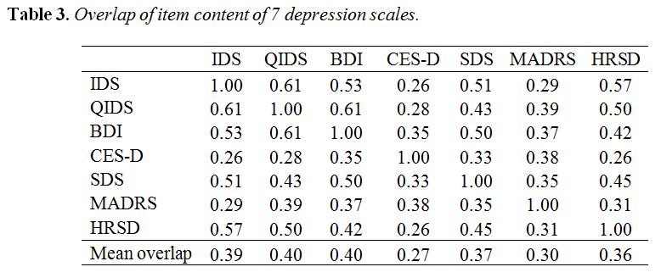
Common scales assess different symptoms

Slide 37
Progress?
1980, DSM-III: "By the time the DSM-IV is released, biomarkers will be readily available for all psychiatric diseases."
35 years and 2 DSM iterations later, we have no single reliable biomarker for any of the main psychiatric disorders. Nonetheless, more of the same attitude prevails.

Slide 38

Progress?
1980, DSM-III: "By the time the DSM-IV is released, biomarkers will be readily available for all psychiatric diseases."
35 years and 2 DSM iterations later, we have no single reliable biomarker for any of the main psychiatric disorders. Nonetheless, more of the same attitude prevails.
2015, Science: "The next few years will undoubtedly see a radical transformation of our understanding of the biological origins of all neuropsychiatric disorders."

Slide 39

Why do we have these research practices,
and where do they come from ?
Why do we look for "depression genes"
or "causes for depression"?

Slide 40
Outline
How MDD research is conducted
MDD research is stuck
MDD is stuck due to problematic assumptions
Symptomics offers new opportunities

Slide 41
Diseases and symptoms
Disease -> symptoms
  Ask patients about symptoms
  Treat disorders, not symptoms
  A symptom is always a symptom of something
Common cause model is standard disease model in general medicine & psychiatry
Notes:
Huge important difference
Use sign and symptom interchangeably here to avoid making it even more complicated.

Slide 42
Common cause model
s1
s2
M
s3
s4
s5

Slide 43
Common cause model
s1
Red eyes
s2
M
s3
s4
s5

Slide 44
Common cause model
s1
Red eyes
s2
Fever
M
s3
s4
s5

Slide 45
Common cause model
s1
Red eyes
s2
Fever
M
s3
Runny nose
s4
Koplik's spots
s5
Cough

Slide 46
Common cause model
s1
Red eyes
s2
Fever
s3
Runny nose
s4
Koplik's spots
s5
Cough

Slide 47
Common cause model
There is a specific relationship between symptoms of a disorder and the disorder itself (common cause model)
s1
Red eyes
s2
Fever
M
s3
Runny nose
s4
Koplik's spots
s5
Cough
Notes:
The latent variable explains the covariation of the indicators

Slide 48
Common cause model
There is a specific relationship between symptoms of a disorder and the disorder itself (common cause model)
  Individuals have the same disease
s1
Red eyes
s2
Fever
M
s3
Runny nose
s4
Koplik's spots
s5
Cough
Notes:
The latent variable explains the covariation of the indicators

Slide 49
Common cause model
There is a specific relationship between symptoms of a disorder and the disorder itself (common cause model)
  Individuals have the same disease
  Symptoms are roughly interchangeable
s1
Red eyes
s2
Fever
M
s3
Runny nose
s4
Koplik's spots
s5
Cough
Notes:
The latent variable explains the covariation of the indicators

Slide 50
Common cause model
There is a specific relationship between symptoms of a disorder and the disorder itself (common cause model)
  Individuals have the same disease
  Symptoms are roughly interchangeable
s1
Red eyes
s2
Fever
M
s3
Runny nose
s4
Koplik's spots
s5
Cough
Notes:
The latent variable explains the covariation of the indicators

Slide 51
Common cause model
There is a specific relationship between symptoms of a disorder and the disorder itself (common cause model)
  Individuals have the same disease
  Symptoms are roughly interchangeable
  Symptoms are unrelated beyond their common cause (LI)
s1
Red eyes
s2
Fever
M
s3
Runny nose
s4
Koplik's spots
s5
Cough
Notes:
The latent variable explains the covariation of the indicators

Slide 52
Psychiatry
Common cause model ubiquitous in psychiatry
s1
D
s2
s3
s4
s5
Notes:
From general medicine to psychiatry, and then to major depressive disorder.

Slide 53
Major Depression
Common cause model
s1
Insomnia
MD
s2
Fatigue
s3
Concentration problems
s4
Psychomotor problems
s5
Weight loss

Slide 54
Major Depression
Common cause model
  We measure symptoms to indicate the disorder
  Add symptoms to total-score to indicate severity
s1
Insomnia
MD
s2
Fatigue
s3
Concentration problems
s4
Psychomotor problems
s5
Weight loss
Notes:
Now we make a big jump to major depression

Slide 55
Major Depression
Common cause model
  We measure symptoms to indicate the disorder
  Add symptoms to total-score to indicate severity
  Symptoms roughly interchangeable
  We want to treat the disease so symptoms disappear
s1
Insomnia
MD
s2
Fatigue
s3
Concentration problems
s4
Psychomotor problems
s5
Weight loss
Notes:
Now we make a big jump to major depression

Slide 56
Major Depression
Common cause model (overly simplistic)
  We measure symptoms to indicate the disorder
  Add symptoms to total-score to indicate severity
  Symptoms roughly interchangeable
  We want to treat the disease so symptoms disappear
s1
Insomnia
MD
s2
Fatigue
s3
Concentration problems
s4
Psychomotor problems
s5
Weight loss
Notes:
Also the jump for evolutionary medicine

Slide 57
Outline
How MDD research is conducted
MDD research is stuck
MDD is stuck due to problematic assumptions
Symptomics offers new opportunities

Slide 58
Symptomics
Individual depression symptoms differ from each other in important properties; symptoms are not just interchangeable or equivalent indicators of one underlying disorder

Slide 59
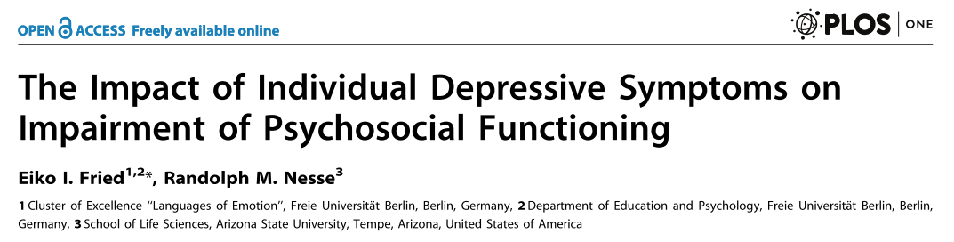
Impairment
MDD causes severe impairment of functioning; unknown whether individual symptoms differ in their impact on impairment
N = 3,703 MDD patients
DOI | 10.1371/journal.pone.0090311

Slide 60
Symptoms vary dramatically in their explained variance of impairment
DOI | 10.1371/journal.pone.009 311
Notes:
((CI obtained through bootstrapping capabilities of rela impo package
Predicted RI by means, not significant.))

Slide 61
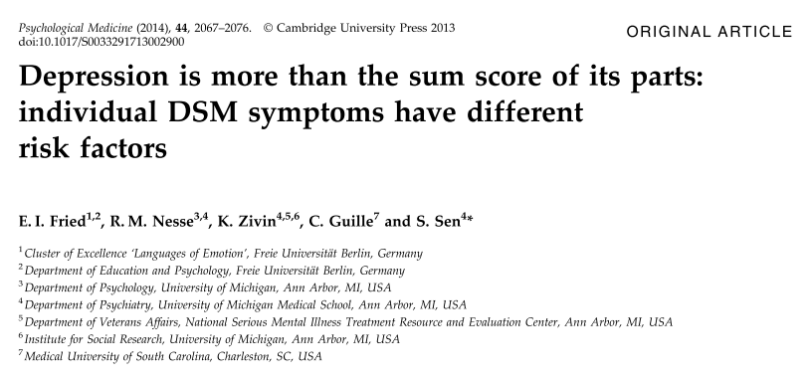
Risk factors
Do depression symptoms have different risk factors?
N = 1289 medical interns before and after internship onset
s1
Insomnia
r1
s2
Fatigue
MD
s3
Concentration problems
r2
s4
Psychomotor problems
s5
Weight loss
DOI | 10.1017/S0033291713002900

Slide 62
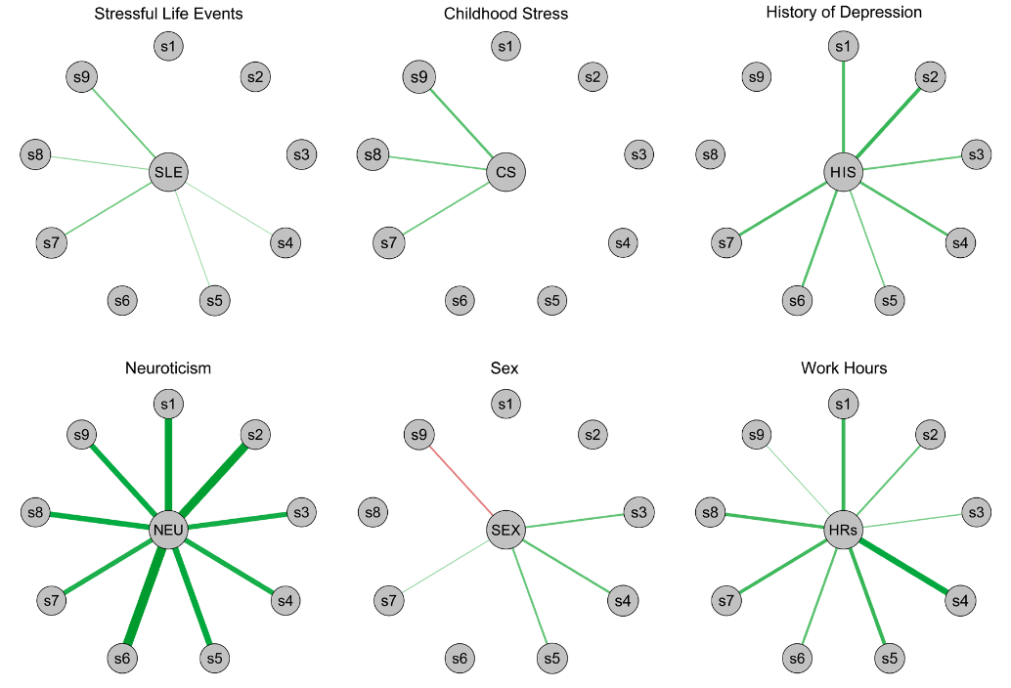
Suicide ♂
Sleep ♀
Concentration ♀
Fatigue ♀
Eating ♀
DOI | 10.1017/S0033291713002900

Slide 63
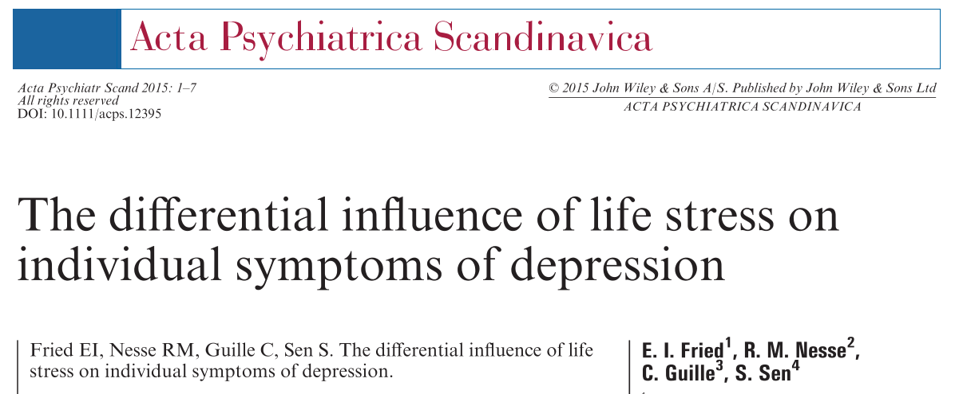
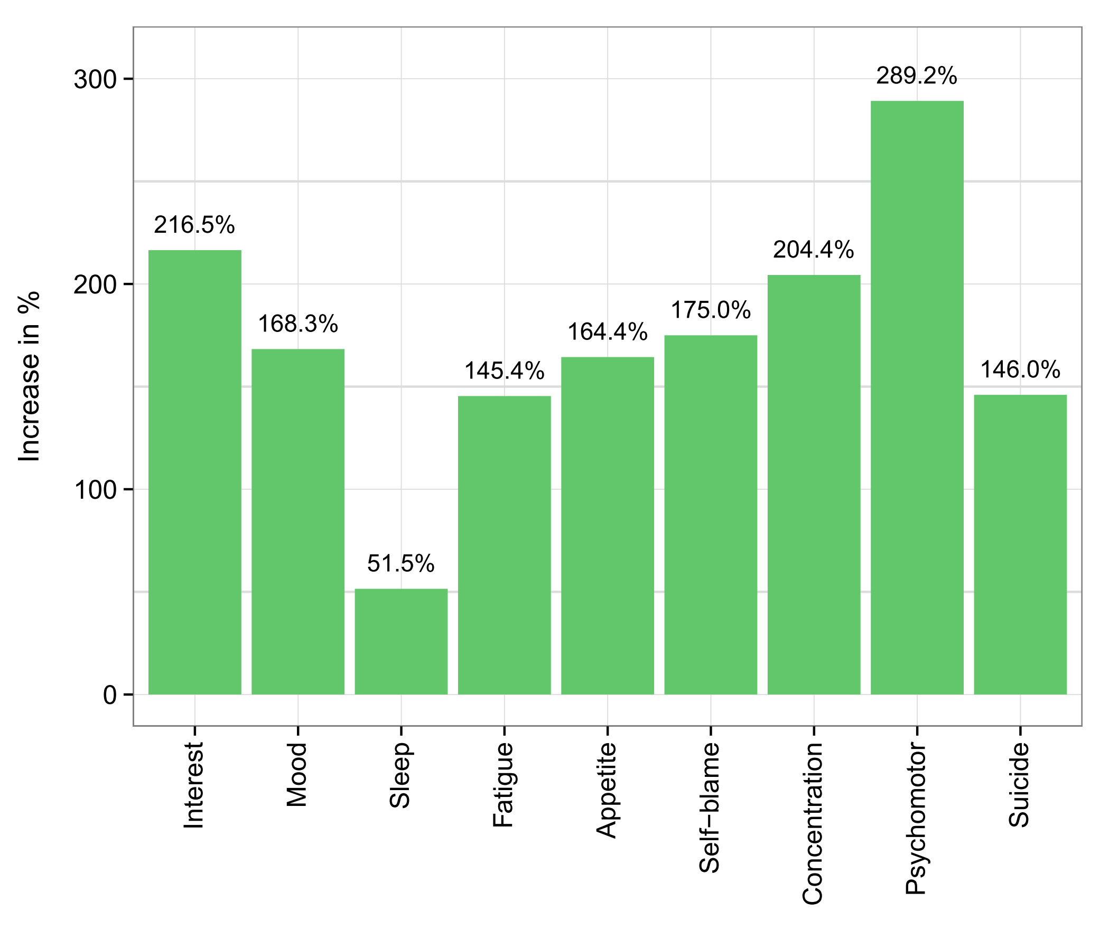
Depression Sx and Stress
DOI | 10.1111/acps.12395

Slide 64
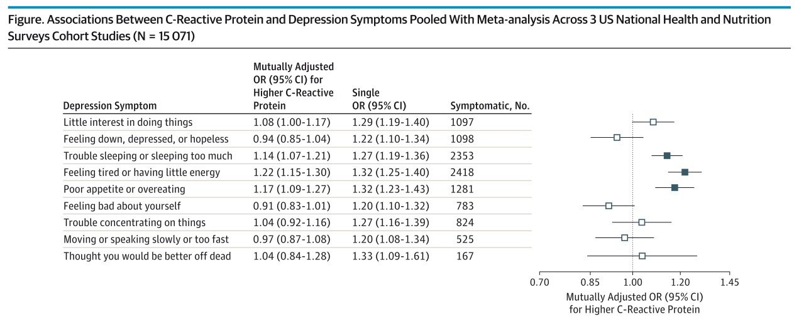
Inflammatory markers
DOI | 10.1001/jamapsychiatry.2015.1977

Slide 65
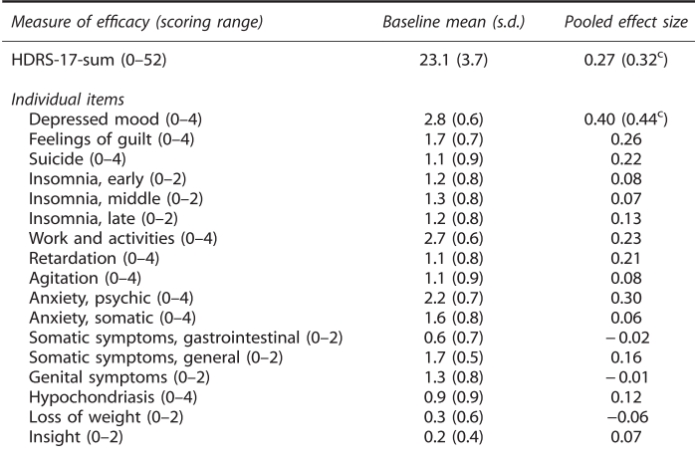
SSRI response
DOI | 10.1038/mp.2015.53

Slide 66
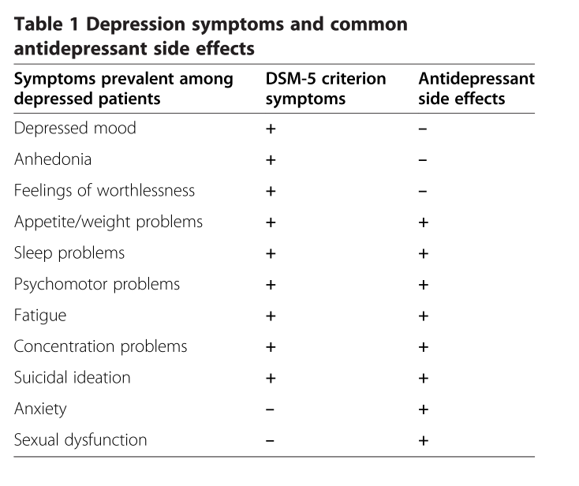
Antidepressants & symptoms
DOI | 10.1186/s12916-015-0325-4

Slide 67
Symptomics
Individual depression symptoms differ from each other in important properties
Network model / complex dynamical systems model

Slide 68
Network model
Symptoms co-occur due to their common cause
DOI | 10.1146/annurev-clinpsy-050212-185608

Slide 69
Network model
Symptoms co-occur because they cause each other
Concentration problems
s5
s2
Fatigue
Insomnia
s1
s3
Psychomotor problems
s4
Weight loss
DOI | 10.1146/annurev-clinpsy-050212-185608
Notes:
Ând we've done a lot of work on this in the last 2 years which I don't have the time to talk about today.

Slide 70
Network model
Symptoms co-occur because they cause each other
Reinforcing feedback loops (attractor state)
Concentration problems
s5
s2
Fatigue
Insomnia
s1
s3
Psychomotor problems
s4
Weight loss
DOI | 10.1146/annurev-clinpsy-050212-185608
Notes:
And this, of course, is consistent with clinical theory.

Slide 71
Network model
Important new questions arise: what symptoms are most central to driving depressive processes?
Concentration problems
s5
s2
Fatigue
Insomnia
s1
s3
Psychomotor problems
s4
Weight loss
DOI | 10.1146/annurev-clinpsy-050212-185608

Slide 72
Network model
Important new questions arise: what symptoms are most central to driving depressive processes?
Concentration problems
s5
s2
Fatigue
Insomnia
s1
s3
Psychomotor problems
s4
Weight loss
DOI | 10.1146/annurev-clinpsy-050212-185608

Slide 73
Network model
Important new questions arise: what symptoms are most central to driving depressive processes?
Concentration problems
s5
s2
Fatigue
Insomnia
s1
s3
Psychomotor problems
s4
Weight loss
DOI | 10.1146/annurev-clinpsy-050212-185608

Slide 74
Research questions
What is the network structure of depression?
  DSM symptoms
  A large number of symptoms above and beyond the DSM criteria
What symptoms are most central, i.e. most connected in the network?
DOI | 10.1016/j.jad.2015.09.005
Notes:
Explain centrality

Slide 75
Study 1
3463 depressed outpatients from the enrollment stage of the STAR*D study
28-item questionnaire that covers 15 disaggregated DSM symptoms and 13 common non-DSM symptoms (e.g., anxiety, irritability)
DOI | 10.1016/j.jad.2015.09.005

Slide 76
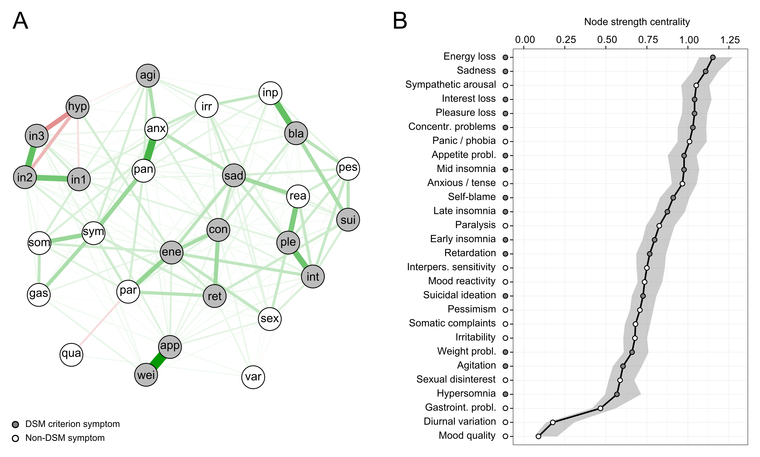
Network structure of MDD
Estimation
Edges equal partial correlations
Sparse network
Interpretation
Heterogeneous network
Some clusters emerge
Sum score problematic
DOI | 10.1016/j.jad.2015.09.005
Notes:
Heterogenous: not common cause
Multiple dependencies! Usually just sum score.

Slide 77
Symptom importance
DOI | 10.1016/j.jad.2015.09.005
Notes:
Conservative estimation of partial correlations
Fruchterman Reingold
Heavily intertwined
Some clusters emerge; explain
Hard to differentiate between symptom grops

Slide 78
Symptom importance
DSM symptoms are not more
central than non-DSM symptoms
DOI | 10.1016/j.jad.2015.09.005
Notes:
Conservative estimation of partial correlations
Fruchterman Reingold
Heavily intertwined
Some clusters emerge; explain
Hard to differentiate between symptom grops

Slide 79
Study 2
Lives of Older Couples (CLOC) study
Baseline: married couples enrolled (60+ years)
Bereaved: N=241
Controls: N=274 (still-married)
Baseline: no differences between bereaved and control participants (age, sex, depressive symptoms)
Baseline
Death
Follow-up
… 6 months …
t
DOI | 10.1037/abn0000028

Slide 80
Bereavement study
Lives of Older Couples (CLOC) study
Baseline: married couples, 65 years or older
Bereaved: N=241
Controls: N=274 (still-married)
Baseline: no differences between bereaved and control participants (age, sex, depressive symptoms)
Baseline
Death
Follow-up
… 37 months …
… 6 months …
t
DOI | 10.1037/abn0000028

Slide 81
Bereavement study
Lives of Older Couples (CLOC) study
Baseline: married couples, 65 years or older
Bereaved: N=241
Controls: N=274 (still-married)
Baseline: no differences between bereaved and control participants (age, sex, depressive symptoms)
Death
Follow-up
… 37 months …
… 6 months …
t
DOI | 10.1037/abn0000028

Slide 82
Bereavement study
DOI | 10.1037/abn0000028

Slide 83
Bereavement study
DOI | 10.1037/abn0000028

Slide 84
Bereavement study
DOI | 10.1037/abn0000028

Slide 85
Bereavement study
DOI | 10.1037/abn0000028
Notes:
The symptom network is cross-sectional, so we have to be careful with a causal interpretation; however, the main finding can likeyl be interpreted causally: loss triggers loneliness, and not the other way around; from there, sypmtom activatoin spreads through the NW.

Slide 86
Conclusions
Core assumptions of universal research practices are not remotely tenable for depression
  Symptoms are not interchangeable
  Symptoms are not passive consequences of a common cause
  Individuals with same diagnosis do not have the same problems
Summing up disparate symptoms is highly problematic
Symptom-based analyses offer a way forward
Notes:
-

Slide 87


Slide 88
Psychometric properties
All commonly used MDD scales were build based on clinical intuition, not psychometric practices. The 3 most commonly used scales today are from 1960, 1961, and 1977
Common interpretations:
  Sum-score is proxy for depression severity. Requires unidimensionality: sum score reflects one underlying construct
  Changes in sum-score over time reflect change in depression. Requires temporal invariance: a scale measures the same construct over time, changes in sum-score reflect changes in the underlying construct(s).

Slide 89
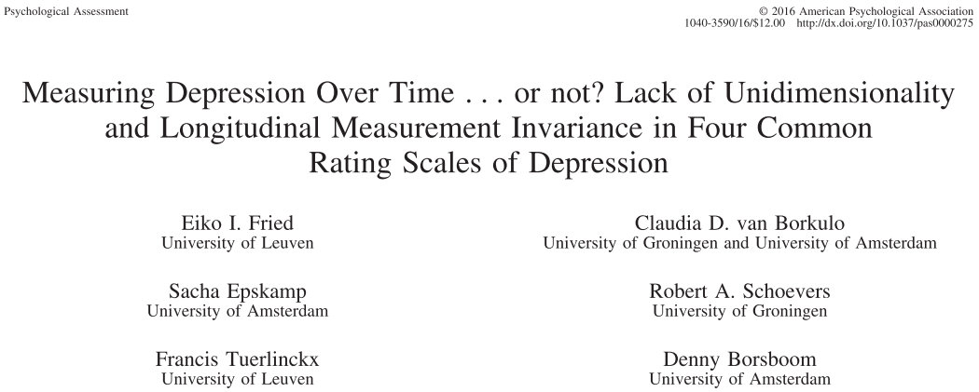
Psychometric properties

Slide 90
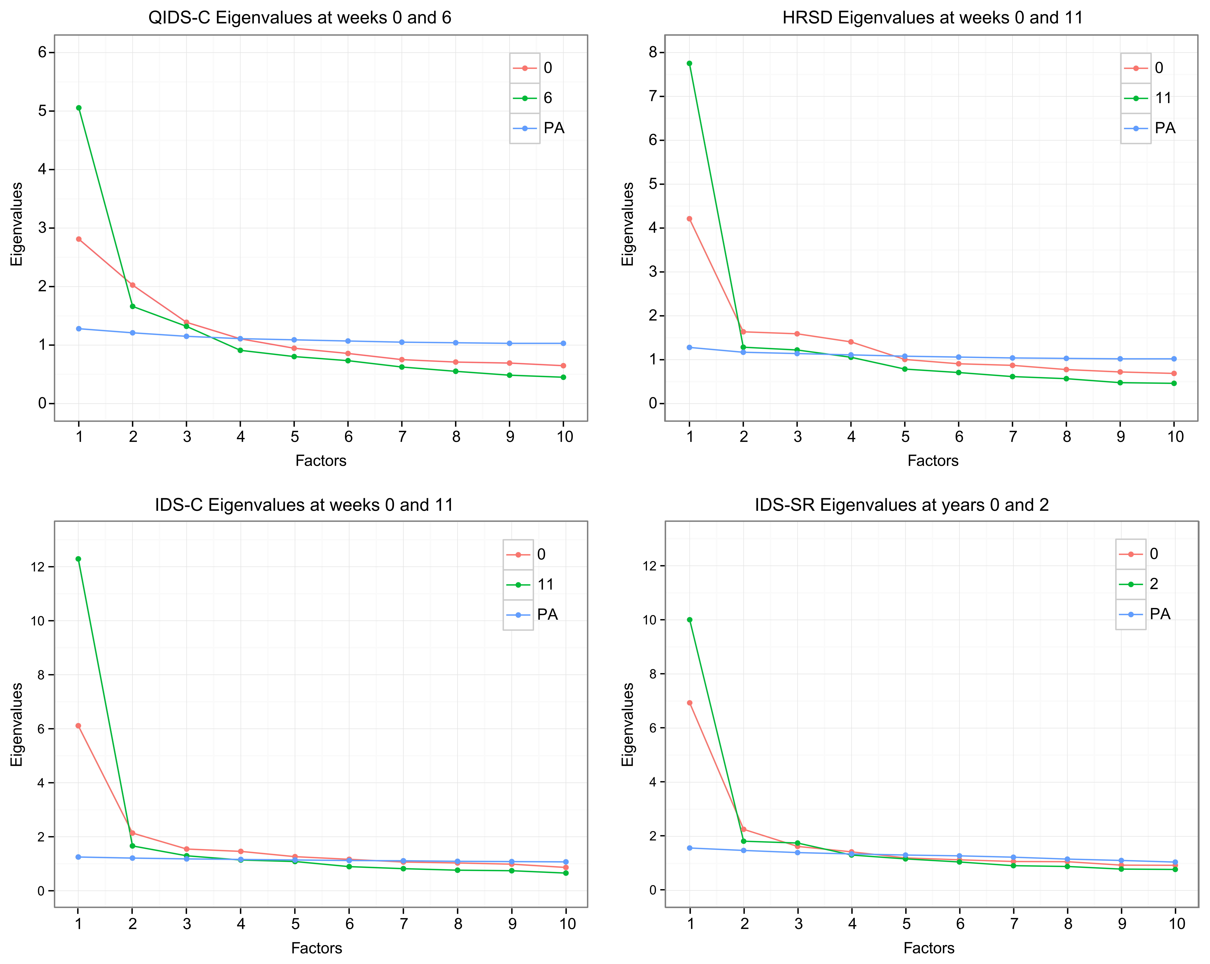
Psychometric properties

Slide 91
Open questions
In which other properties do symptoms differ?
Are there other groups of disorders for which symptom-based analysis and network analysis may provide important insights?
For which mental disorders is the common cause model more tenable?
Are there "hybrid" scenarios where (local) common causes (e.g., disorder onset) and dynamical systems (e.g., disorder maintenance) go together?

Slide 92
Problems and challenges
Reliability of symptom measurement
Robustness of network research (confidence intervals around centrality estimates, edge CI, etc.)
Heterogeneity of large cross-sectional networks
  Lack of generalizability of idiographic networks
Topological overlap

Slide 93










Thank you

Slide 94
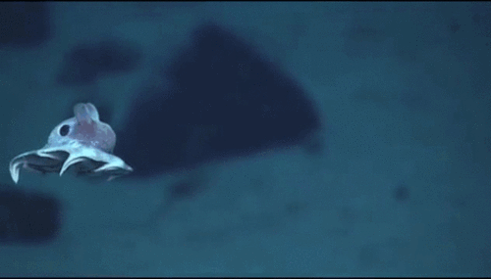
Questions & discussion

