Slide 1
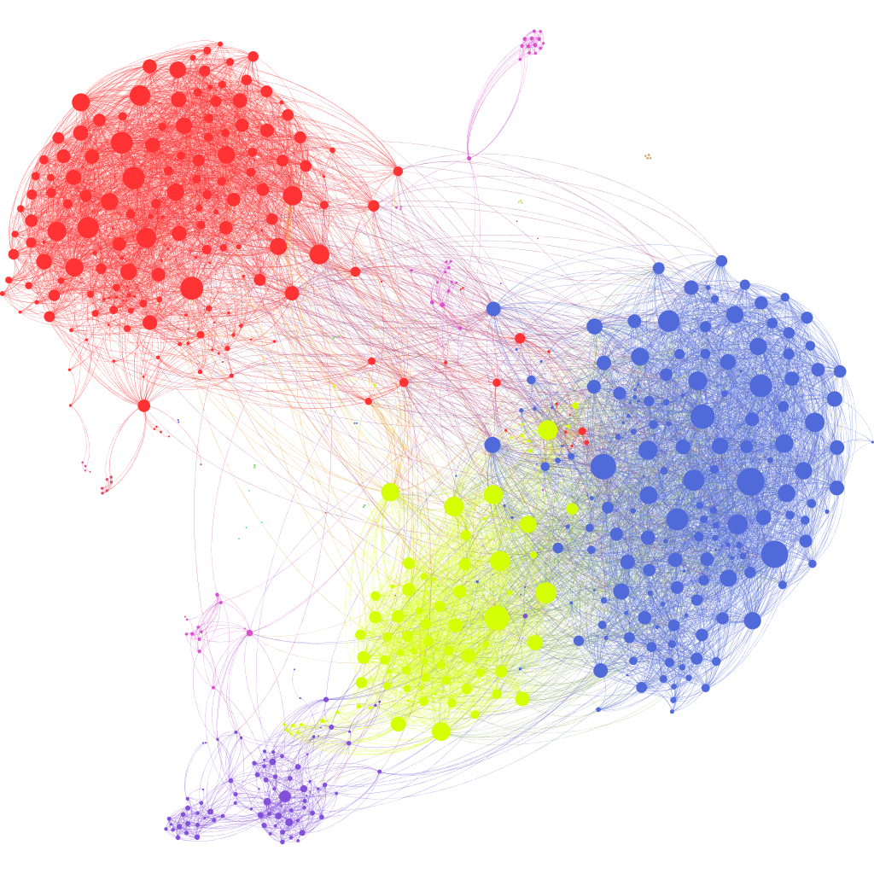

The network approach to psychopathology: implications for clinical research and practice
Eiko Fried
Department of Psychological Methods
University of Amsterdam
www.eiko-fried.com/VGCT2017

Slide 2
Overview
Social networks
Nomenclature & concepts
Psychopathology networks
Cross-sectional networks
Time-series networks
Application examples
Materials
VGCT November 2017

Slide 3
Social networks
Chapter 1
Most examples from https://github.com/briatte/awesome-network-analysis

Slide 4
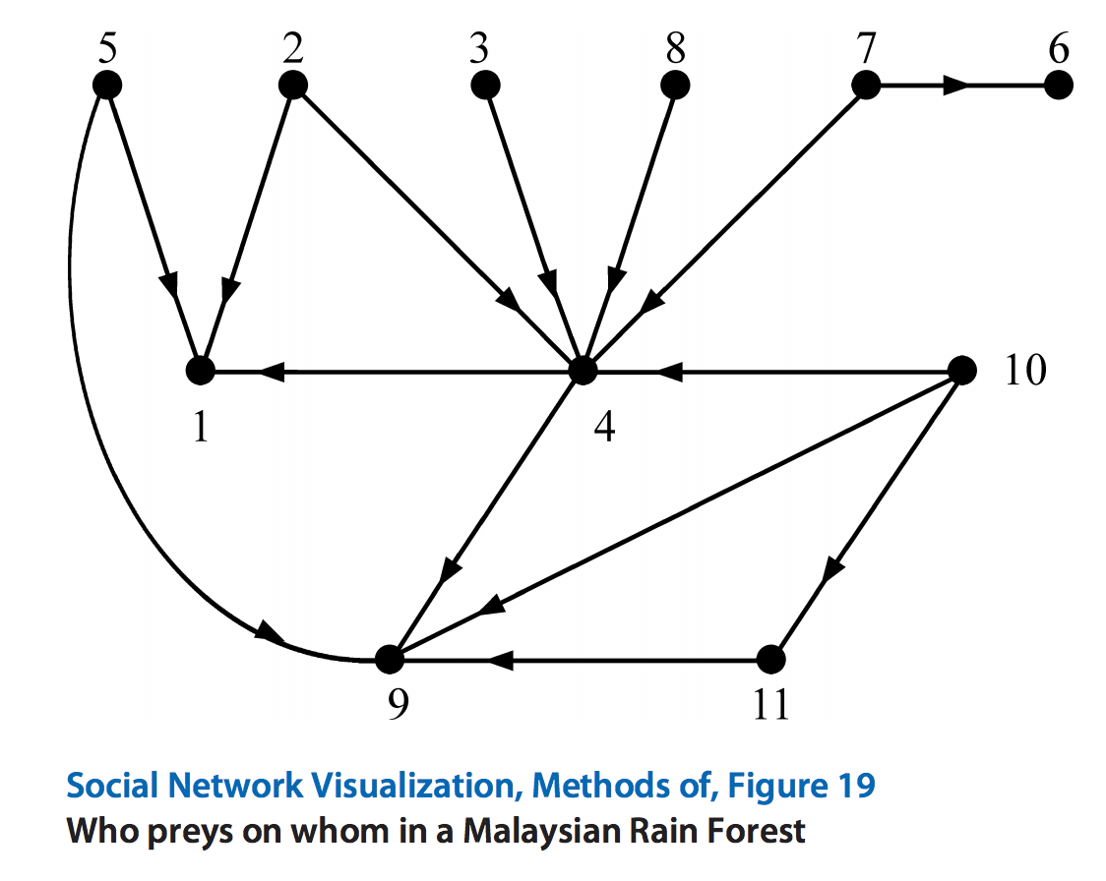

Slide 5
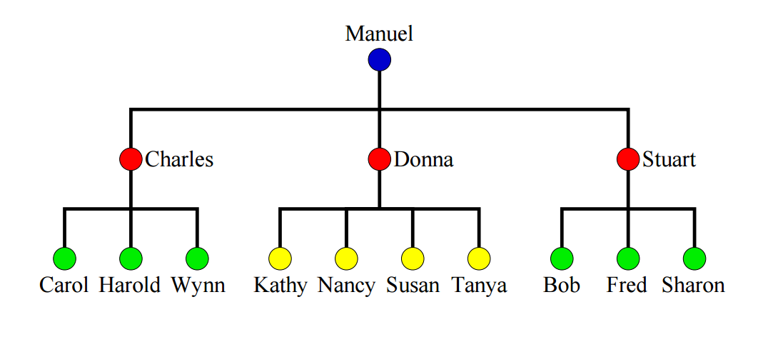
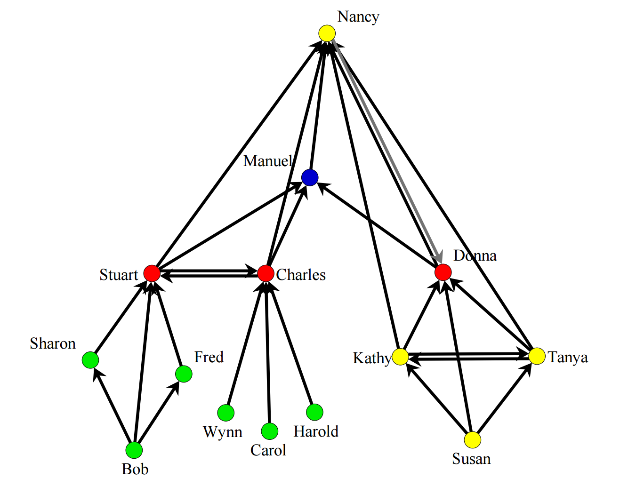

Slide 7
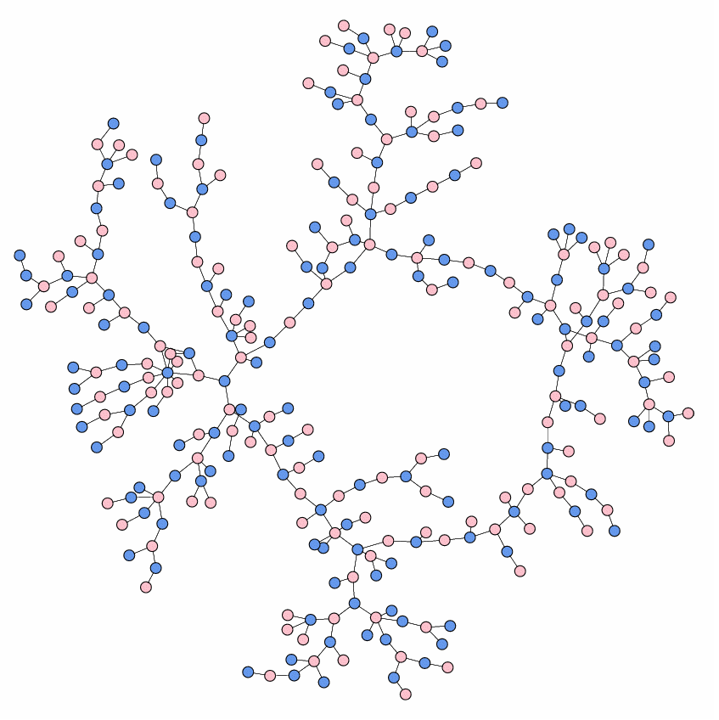
Notes:
Romantic relations in the last 6 months, Jefferson High School
American Journal of Sociology, Vol. 100, No. 1."Chains of affection: The structure of adolescent romantic and sexual networks," Bearman PS, Moody J, Stovel K.

Slide 8
Nomenclature & concepts
Chapter 2

Slide 9
Networks
A network is a set of nodes connected by a set of edges
A node represents an entity
  People
  Cities
  Symptoms
  Psychological construct

Slide 10
Networks
An edge represents some connection between two nodes
Friendship / contact
Distance
Comorbidity
Causality
Interaction

Slide 11
Networks
Edges can be weighted or unweighted

Slide 12
Signs of edges
Edges can have a sign (positive / negative)

Slide 13
Networks
Networks can be directed or undirected

Slide 14
Psychopathology networks
Chapter 3

Slide 15
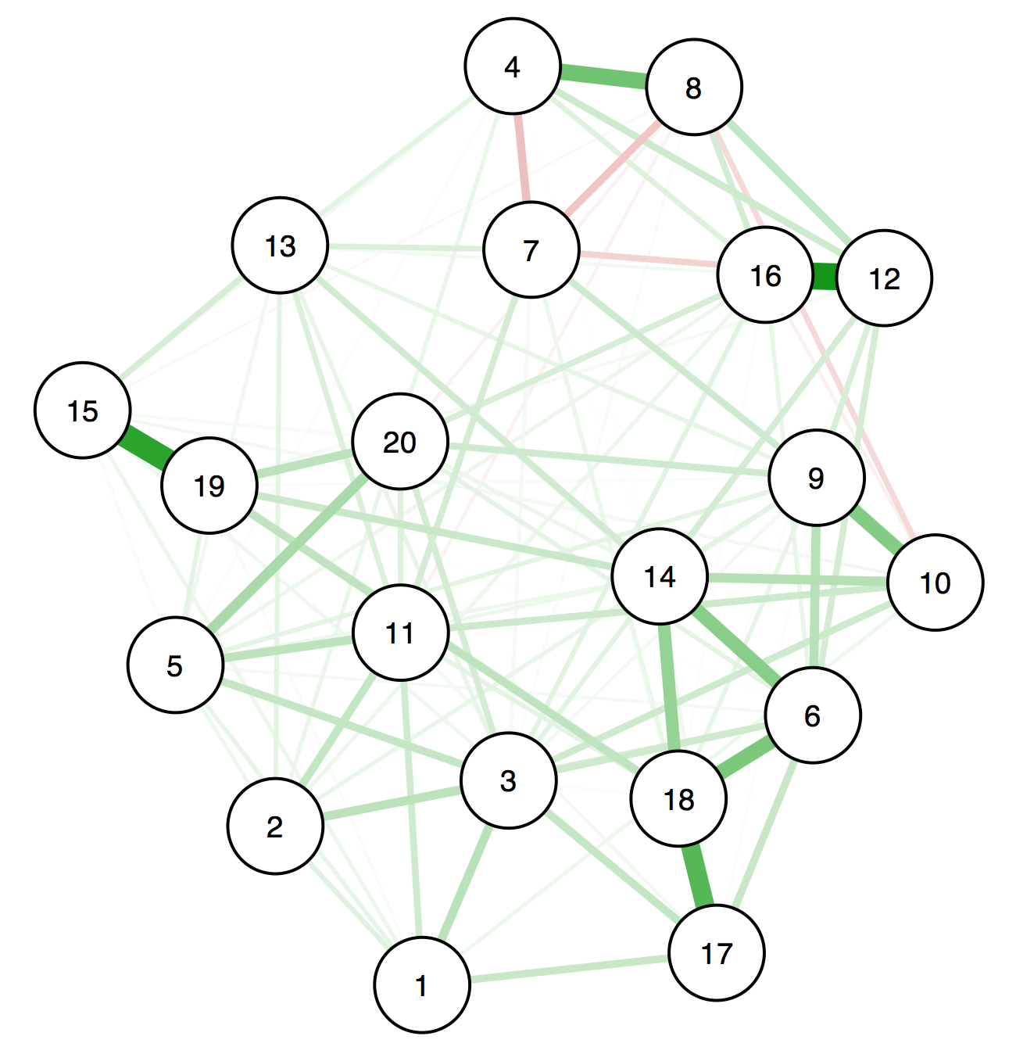
Psychopathology networks
Psychological networks differ from networks of many other disciplines in one very fundamental aspect
  Edges are not observed and need to be estimated
  (https://arxiv.org/abs/1604.08462) → Network Psychometrics

Slide 16
Why do symptoms cluster in syndromes?

Slide 17
Common cause framework
Disorders itself are latent—we cannot observe measles directly
M

Slide 18
Common cause framework
Disorders itself are latent—we cannot observe measles directly
We can only observe the symptoms of measles
We can use symptoms to indicate the presence of measles
s1
M
s2
s3

Slide 19
Common cause framework
Disorders itself are latent—we cannot observe measles directly
We can only observe the symptoms of measles
We can use symptoms to indicate the presence of measles
  This works because measles causes measles symptoms
s1
M
s2
s3

Slide 20
Common cause framework
The CC framework is responsible for symptom checklists in the rest of medicine and psychiatry
  We use symptom lists to determine the presence of an underlying disease
The CC framework explains why symptoms cluster: they have the same causal origin
  Fever, generalized rash, Koplik's spots → measles
s1
M
s2
s3

Slide 21
Common cause framework
What does this mean for symptoms?
  Symptoms are equivalent & interchangeable indicators of underlying disease ("assumption of symptom equivalence")
  Symptom number, not symptom nature is relevant
  Symptoms are "locally independent"; since they are derived from the same common cause, their correlations are spurious
s1
M
s2
s3

Slide 22
Network perspective
Traditional: symptoms cluster because of a shared origin
Network: symptoms cluster bc they influence each other

Slide 23

Network perspective
Symptoms as separate entities that differ in important aspects
More than interchangeable indicators of underlying disorder

Slide 24
Cross-sectional networks
Chapter 4

Slide 25
Regularized partial correlation networks
Data: often between 300 and 3000 observations, 10-30 symptom variables; cross-sectional
Models: undirected; pairwise Markov Random Fields / regularized partial correlation networks; conditional independence relations
  Binary data: Ising Model
  Gaussian data: Gaussian Graphical Model (GGM)
  Mixed data: Mixed Graphical Model
Estimation: R-packages IsingFit, qgraph, mgm, & bootnet

Slide 26
PTSD dataset, n=221, DSM-5 Sx
URL | Reproducible example of data + code at http://eiko-fried.com/asawebinar2017/

Slide 27
Regularization
PMRFs require a lot of data because many parameters are estimated
A network with 20 nodes already has 190 edge parameters, a 50-node network has 1225 edge parameters
  For i nodes: (i * i - 1) / 2 edge weights + i thresholds
Our goal is to obtain
  Easily interpretable / parsimonious network
  Stable network that more likely reflects our true data generating model

Slide 28
Regularization
How do we do that: via regularization.
Tutorial paper with explanations:
  Tutorial on regularized partial correlation networks (accepted at Psychological Methods) https://arxiv.org/abs/1607.01367

Slide 29
Regularization
Solution: estimate networks with the lasso
The lasso shrinks all regression coefficients, and small ones are set to zero (drop out of the model)
  Interpretability: only relevant edges retained in the network
  Stability/replicability: avoids obtaining spurious edges only due to chance
  We also have less parameters to estimate
Regularization returns a sparse network: few edges are used to explain the covariation structure in the data (parsimony)

Slide 30
Regularization
We use the eLasso (Ising Model) or glasso (GGM) that selects the optimal value of the tuning parameter λ based on minimizing the Extended Bayesian Information Criterion (EBIC)
  100 models are estimated, the one with the lowest EBIC is picked
The EBIC hyperparameter γ decides how many edges we recover. Setting γ to 0 leads to a network based on the BIC (non-conservative, erring on the side of discovery);
γ defaults for erring on the side of caution are 0.25 (Ising Model) and 0.5 (GGM)

Slide 31
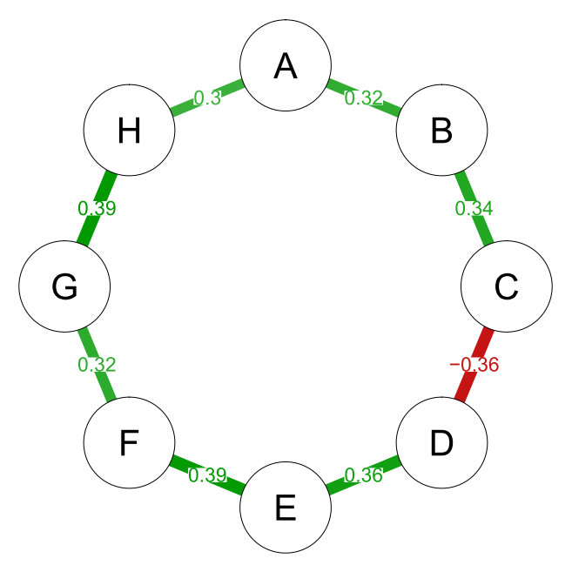
Example
True network
URL | https://arxiv.org/abs/1607.01367

Slide 32
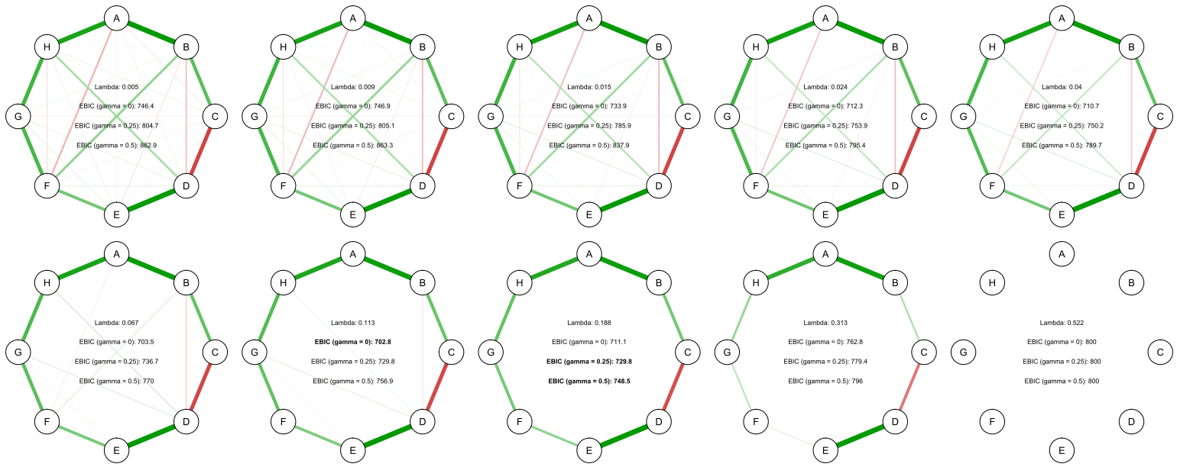
Example
Automatically calculate 100 networks (by varying λ)
URL | https://arxiv.org/abs/1607.01367
Notes:
We use the eLasso (EBIC Lasso) that selects the optimal value of the tuning parameter λ (lamdba) based on minimizing the Extended Bayesion Information Criterion (EBIC)
Many models are estimated, the one with the best fit (lowest EBIC) is picked
The EBIC hyperparameter γ (gamma) decides how many edges we recover. Setting γ to 0 leads to a network based on the BIC (non-conservative, erring on the side of discovery);
γ defaults for erring on the side of caution are 0.25 (Ising Model) and 0.5 (GGM)

Slide 33
Example
Pick best model via EBIC, depending on setting for γ
URL | https://arxiv.org/abs/1607.01367
Notes:
We use the eLasso (EBIC Lasso) that selects the optimal value of the tuning parameter λ (lamdba) based on minimizing the Extended Bayesion Information Criterion (EBIC)
Many models are estimated, the one with the best fit (lowest EBIC) is picked
The EBIC hyperparameter γ (gamma) decides how many edges we recover. Setting γ to 0 leads to a network based on the BIC (non-conservative, erring on the side of discovery);
γ defaults for erring on the side of caution are 0.25 (Ising Model) and 0.5 (GGM)

Slide 34
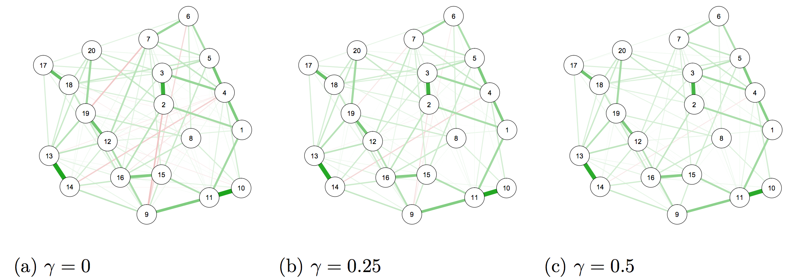
Example

Slide 35
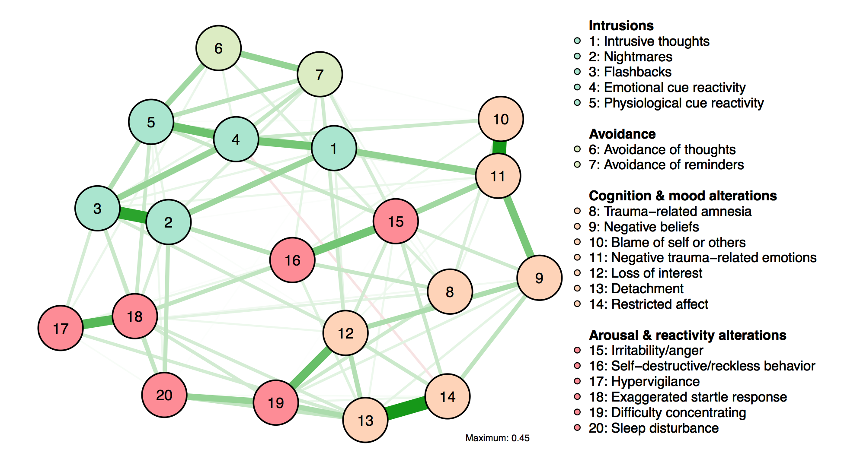
URL | Reproducible example of data + code at http://eiko-fried.com/asawebinar2017/

Slide 36
Paper accepted at Clinical Psychological Science | https://osf.io/2t7qp/

Slide 41
Correlations: 0.63 to 0.75, mean = 0.72
Notes:
Strength centrality is shown in Figure 3; the centrality order was substantially related across the four networks, with correlations ranging from 0.63 (networks 2 and 3) to 0.75 (networks 2 and 4). Amnes (7), EmoNumb (10), and Irrit (13) had consistently low centrality estimates (all standardized centrality estimates considerably below 0), whereas Intr (1), Detach (9), and React (4) emerged as consistently central symptoms.

Slide 42
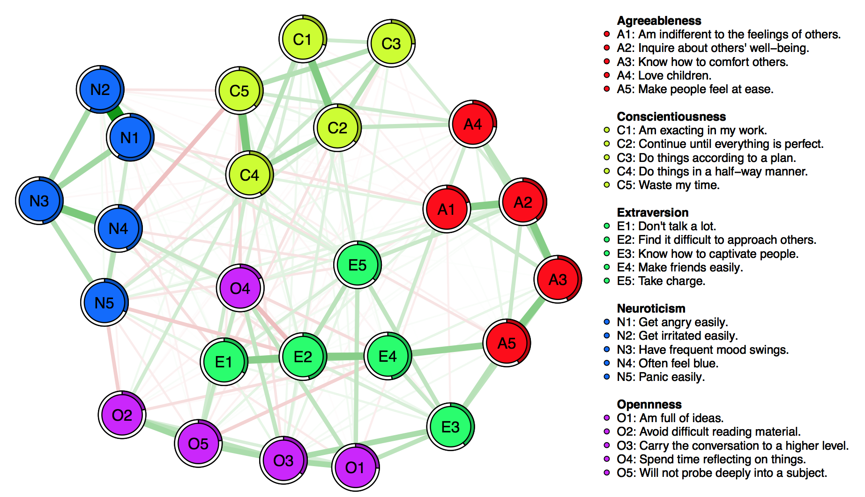
Big 5
DATA | R, library("psych"), data("bfi")
Notes:
N1 N2 possibly measure the same variable

Slide 43
Time-series networks
Chapter 5

Slide 44
Time-series models
Data: often between 1 and 50 people, 3-20 symptom variables
Models: directed; vector autoregressive model (multilevel, time-varying, with meausurement error)
Estimation:
  R-packages graphicalVAR (n=1) & mlVAR (n>1)
  Mplus: DSEM

Slide 45
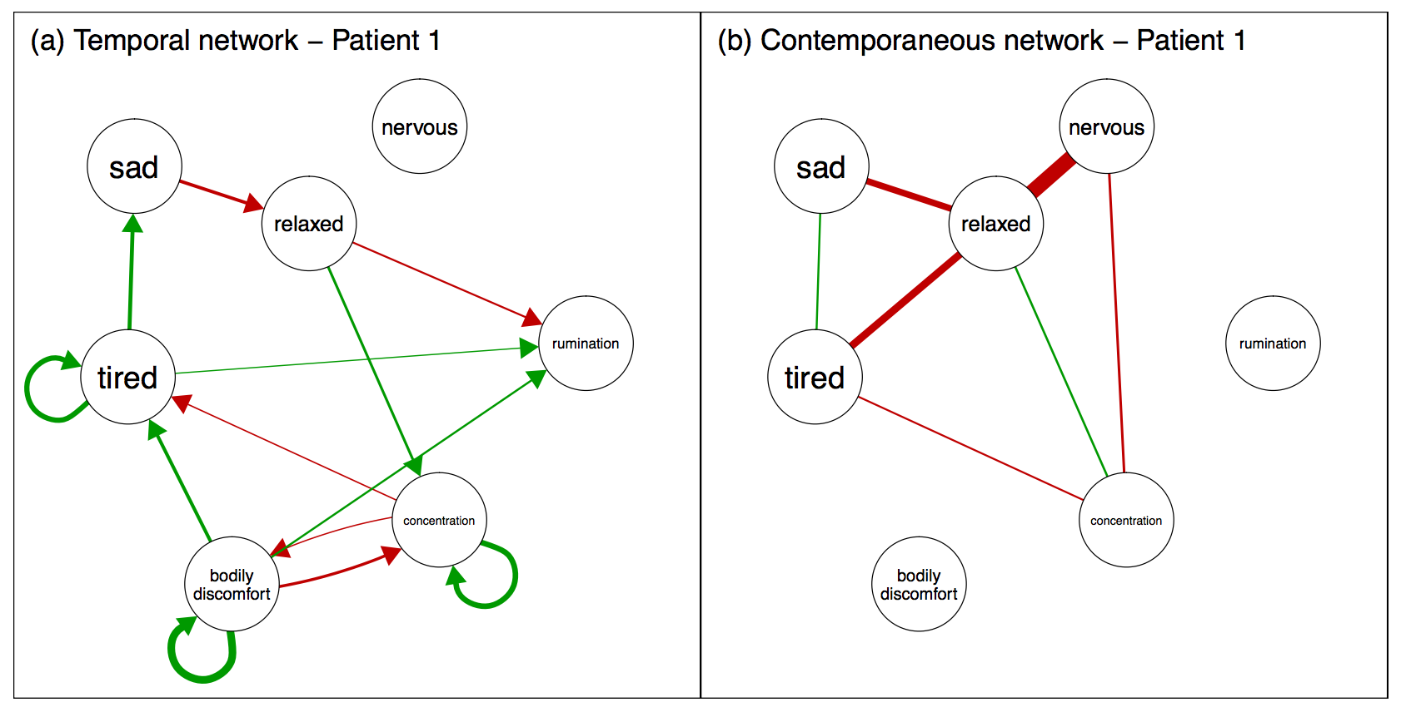
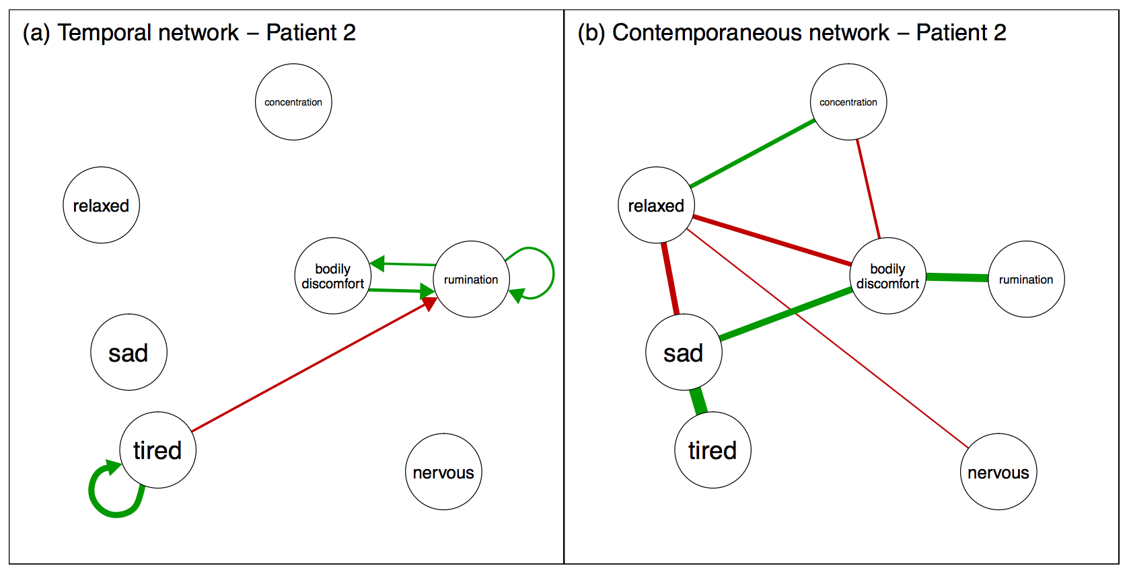
Preprint:
https://arxiv.org/pdf/1609.04156.pdf

Slide 46
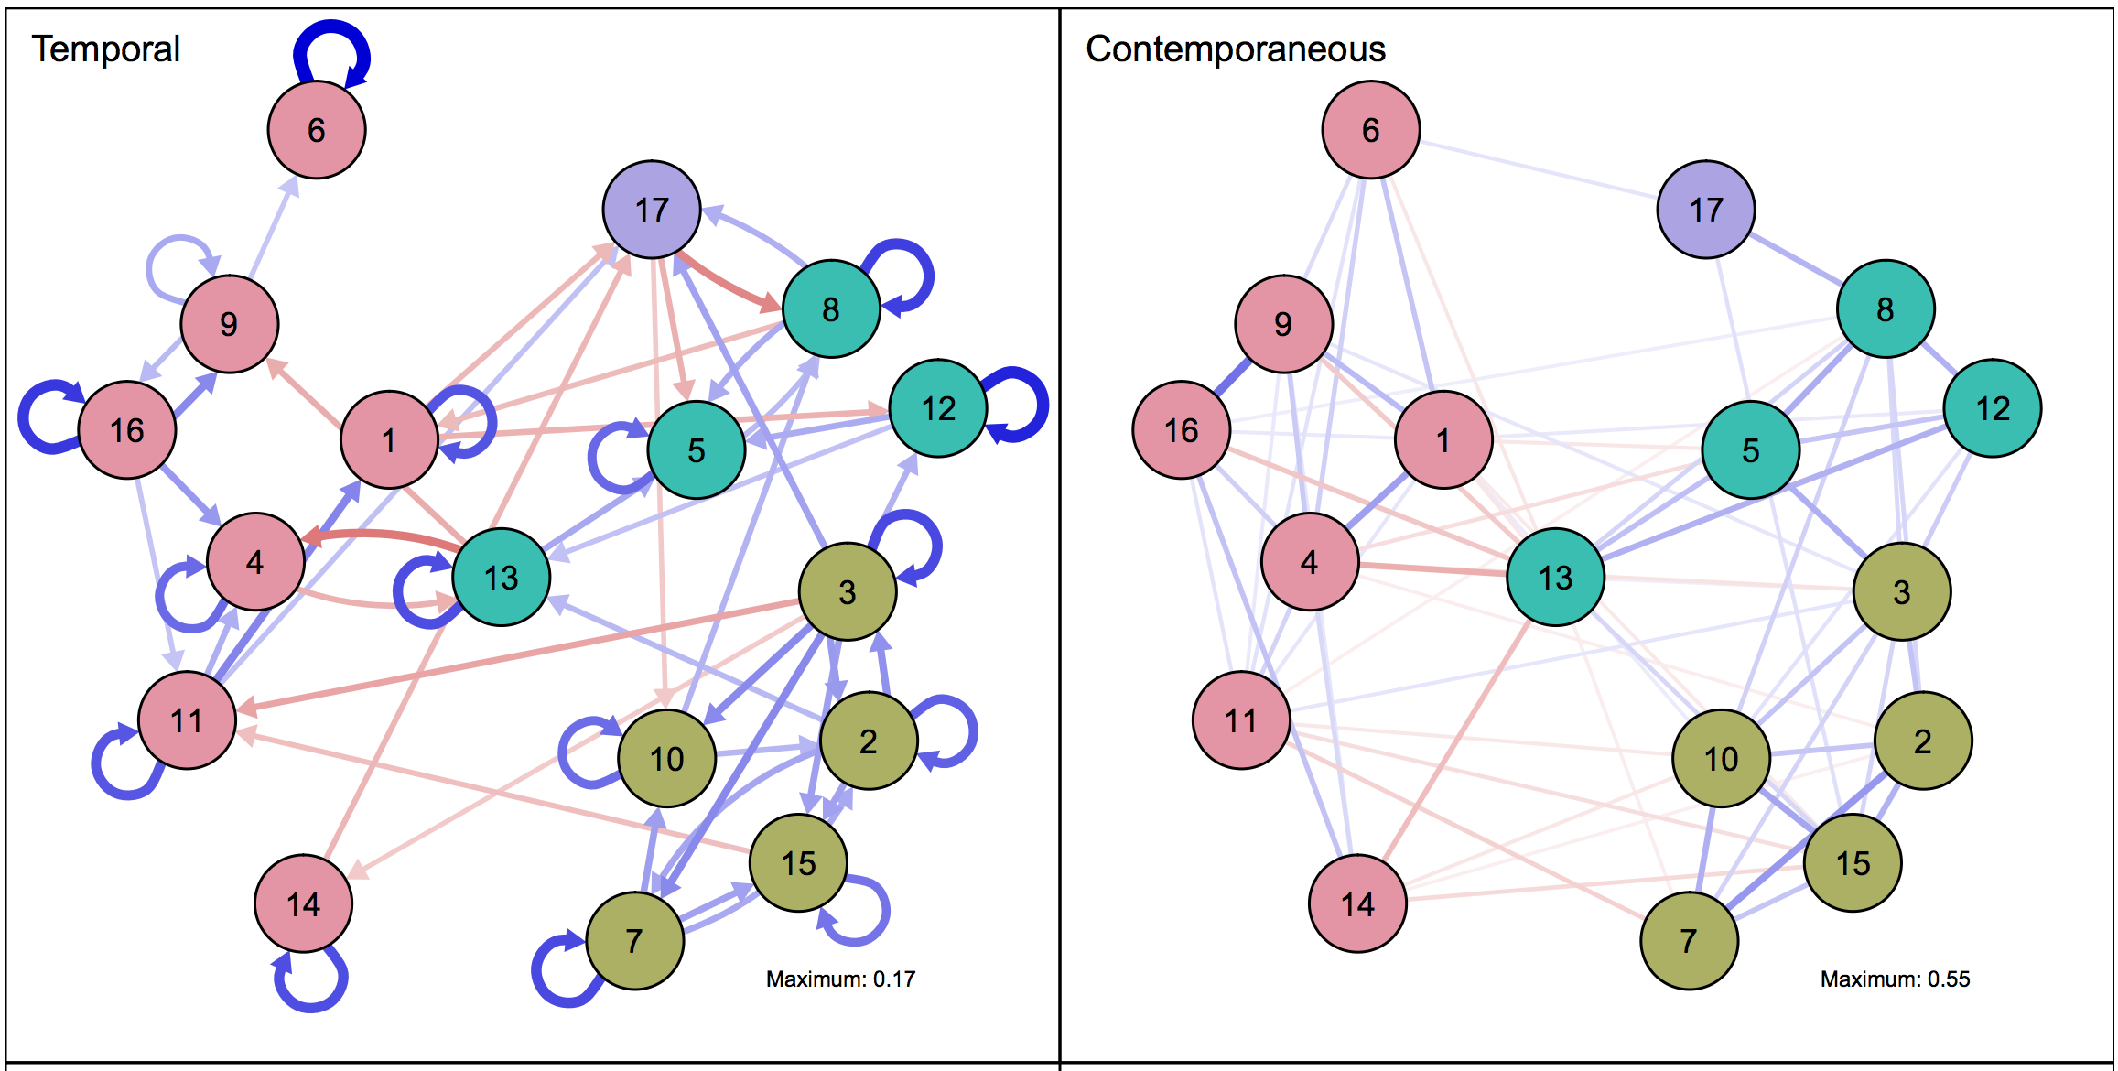
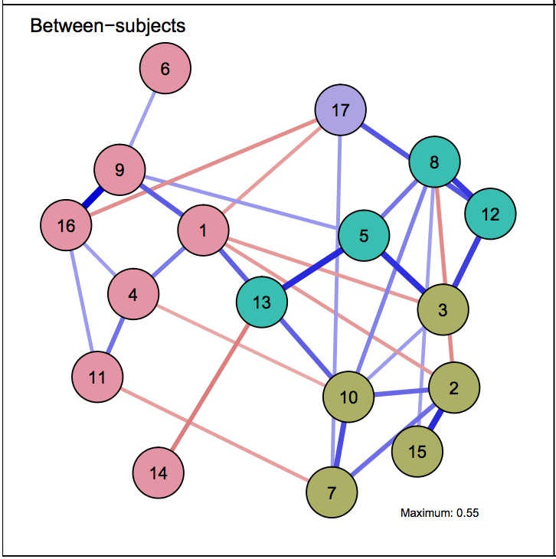
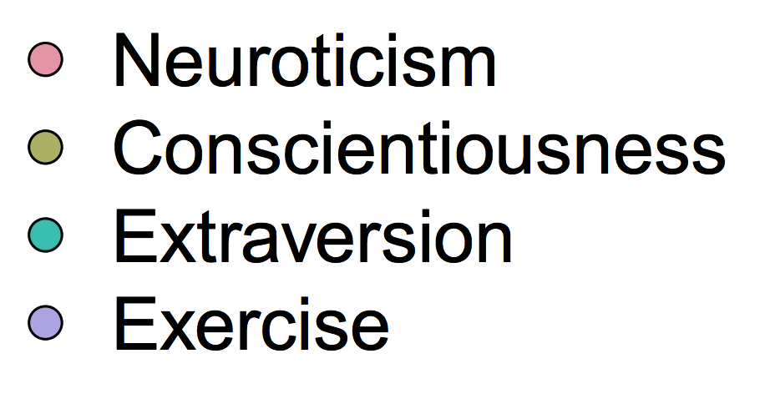
6: self-conscious
8: energetic; 17: exercise
9: frustrated; 16: angry
12: adventurous
Preprint | https://arxiv.org/pdf/1609.04156.pdf
Notes:
6: self concious
1 = “Worried”; 2 = “Organized”; 3 = “Ambitious”; 4 = “Depressed”; 5 = “Outgoing”; 6 = “Self-Conscious”; 7 = “Self-Disciplined”; 8 = “Energetic”; 9 = “Frustrated”; 10 = “Focused”; 11 = “Guilty”; 12 = “Adventurous”; 13 = “Happy”; 14 = “Control”; 15 = “Achieved”; 16 = “Angry”; 17 = “Exercise.”

Slide 47
Time-series networks n>1
Laura Bringmann, Sacha Epskamp, Kirsten Bulteel, Noémi Schuurman, Ellen Hamaker, Aaron Fisher, Marieke Wichers ...

Slide 48
Asleep?!

Slide 49

Asleep?!

Slide 50
Application examples
Chapter 6

Slide 51
Implications for treatment

Slide 52
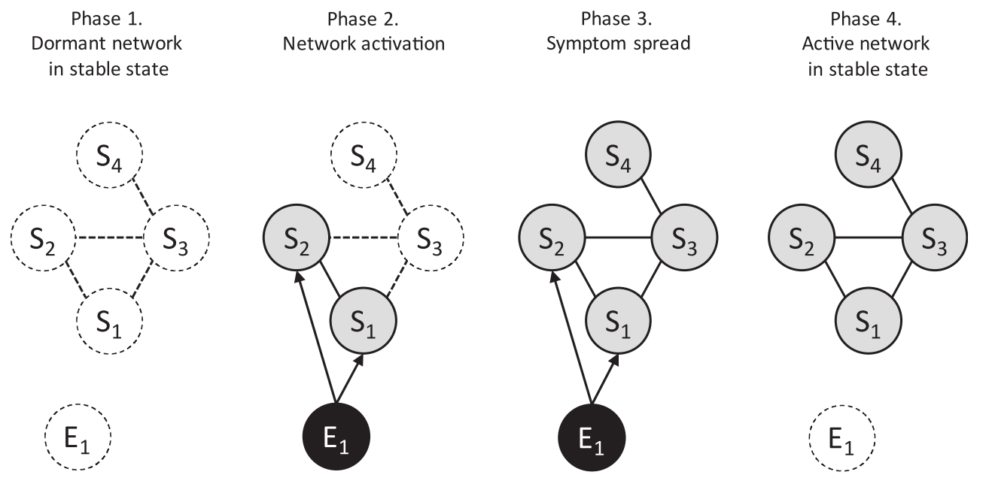
Development of psychopathology
DOI | 10.1002/wps.20375

Slide 53
Vulnerability
DOI | 10.1002/wps.20375

Slide 54
Substance abuse networks
DOI | 10.1016/j.drugalcdep.2016.02.005; D2—withdrawal, D5—monopolizes time

Slide 55
Substance abuse networks
DOI | 10.1016/j.drugalcdep.2016.02.005

Slide 56
Bereavement
DOI | 10.1037/abn0000028

Slide 57
Comorbidity
URL | https://osf.io/6n8cg/

Slide 58
Community detection
URL | http://wp.me/p801LW-4c

Slide 59
Hybrid models
  Common causes for some sets of symptoms?
  Trauma → PTSD symptoms
  Particular life events → particular depression symptoms
DOI | 10.1177/1745691617705892

Slide 60
Hybrid models
  Common causes for some sets of symptoms?
  Trauma → PTSD symptoms
  Particular life events → particular depression symptoms
DOI | 10.1177/1745691617705892

Slide 61
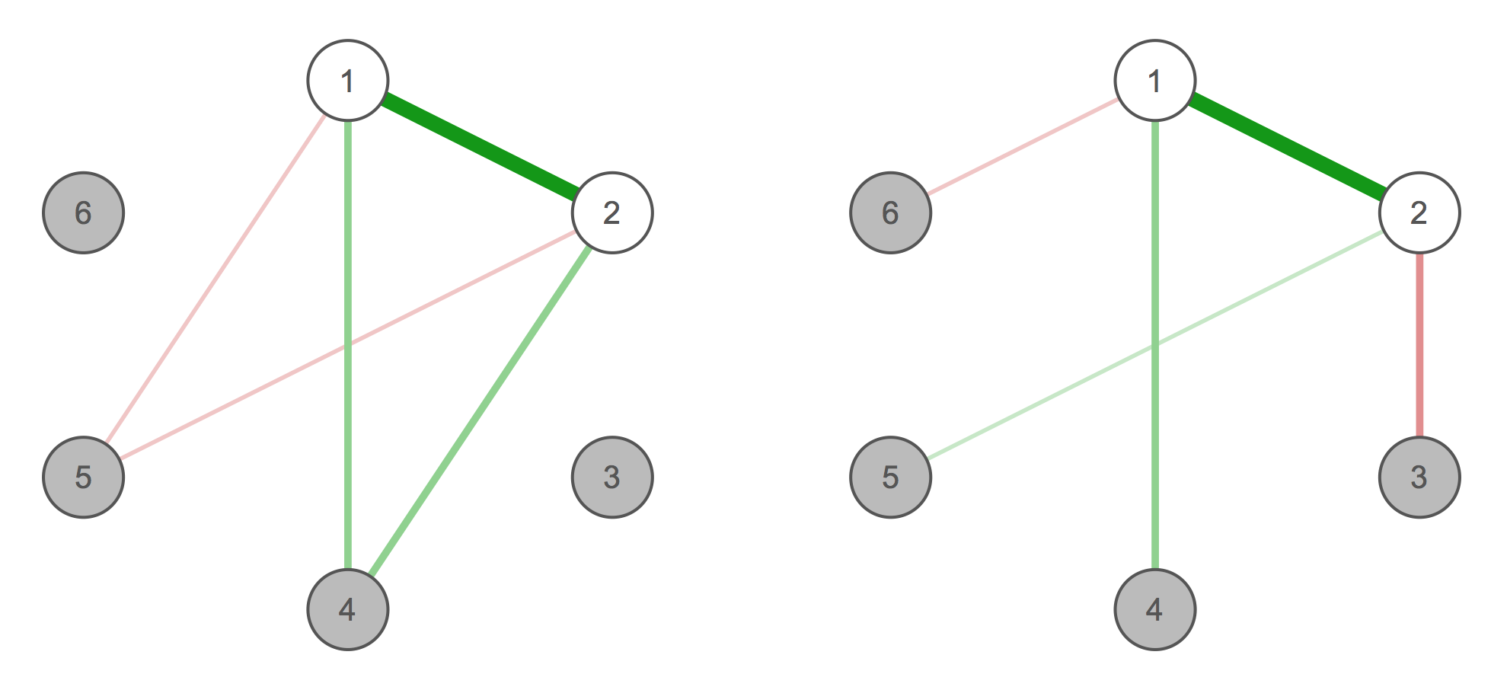
What variables to include
  Some questionnaire seem to measure the same variable multiple times
  CES-D: ‘sad mood’, ‘depressed mood’, ‘feeling blue’
DOI | 10.1177/1745691617705892

Slide 62
Materials
Chapter 7

Slide 63
Statistical tutorials
  http://eiko-fried.com/asawebinar2017
  Tutorial on regularized partial correlation networks (accepted at Psychological Methods) https://arxiv.org/abs/1607.01367
Epskamp, S., Borsboom, D., & Fried, E. I. (2017). Estimating Psychological Networks and their Accuracy: A Tutorial Paper. Behavior Research Methods, 1–34.
  www.SachaEpskamp.com/Dissertation
  Psychological Networks Amsterdam Summer School 2017; https://osf.io/3vqhx
  More at: http://psych-networks.com/tutorials/

Slide 64
Network theory
  Fried, E. I., & Cramer, A. O. J. (2017). Moving forward: challenges and directions for psychopathological network theory and methodology. Perspectives on Psychological Science, 1–22.
  Borsboom, D. (2017). A network theory of mental disorders. World Psychiatry, 16, 5–13.
  Fried, E. I., van Borkulo, C. D., Cramer, A. O. J., Boschloo, L., Schoevers, R. A., & Borsboom, D. (2017). Mental disorders as networks of problems: a review of recent insights. Social Psychiatry and Psychiatric Epidemiology, 52(1), 1–10.
  McNally, R. J. (2016). Can network analysis transform psychopathology? Behaviour Research and Therapy, 86, 95–104.
  More at: http://psych-networks.com/tutorials/

Slide 65
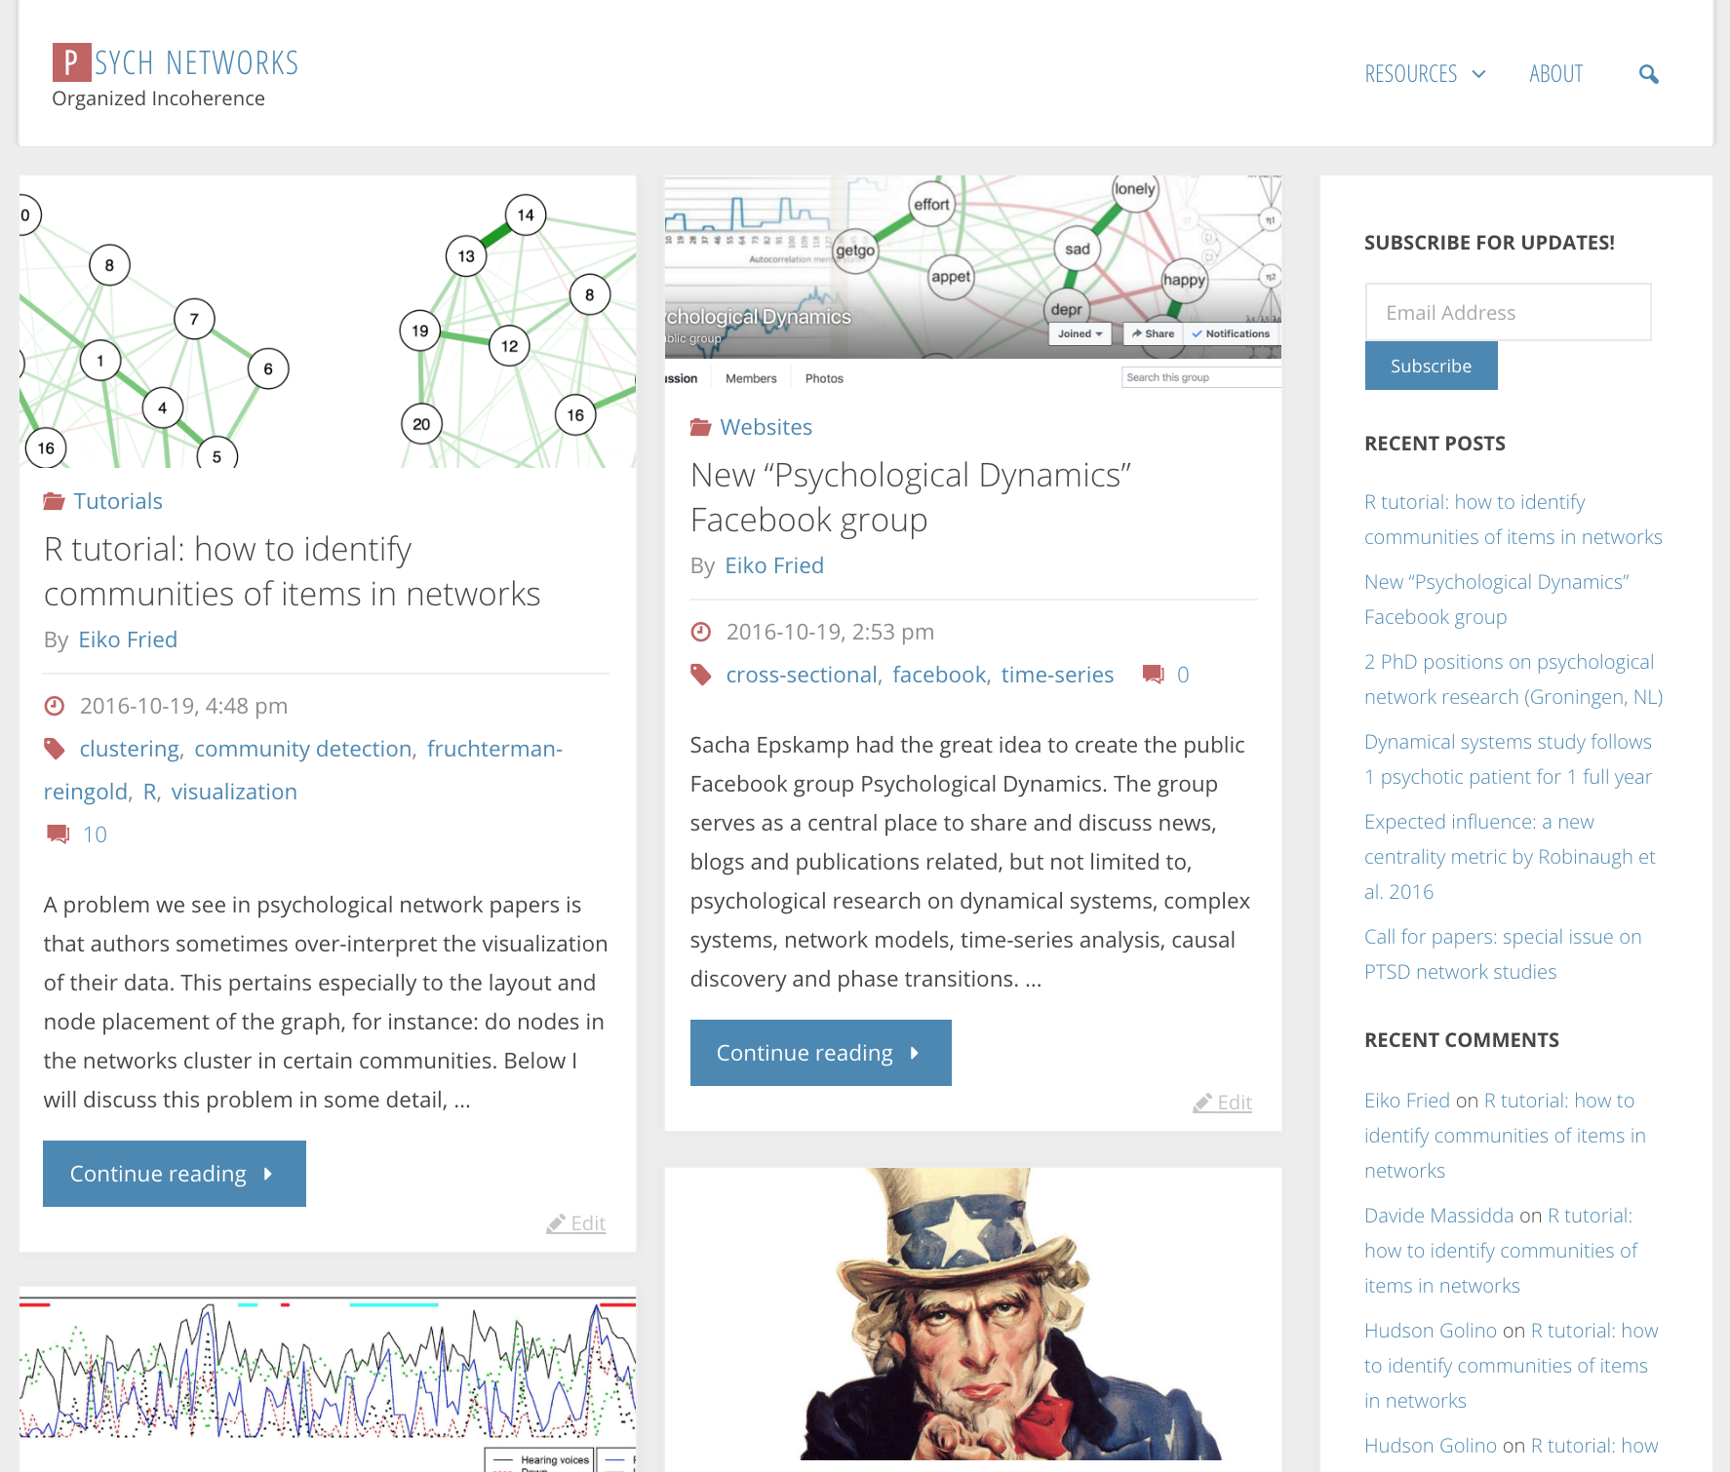
www.psych-networks.com

Slide 66


Slide 67
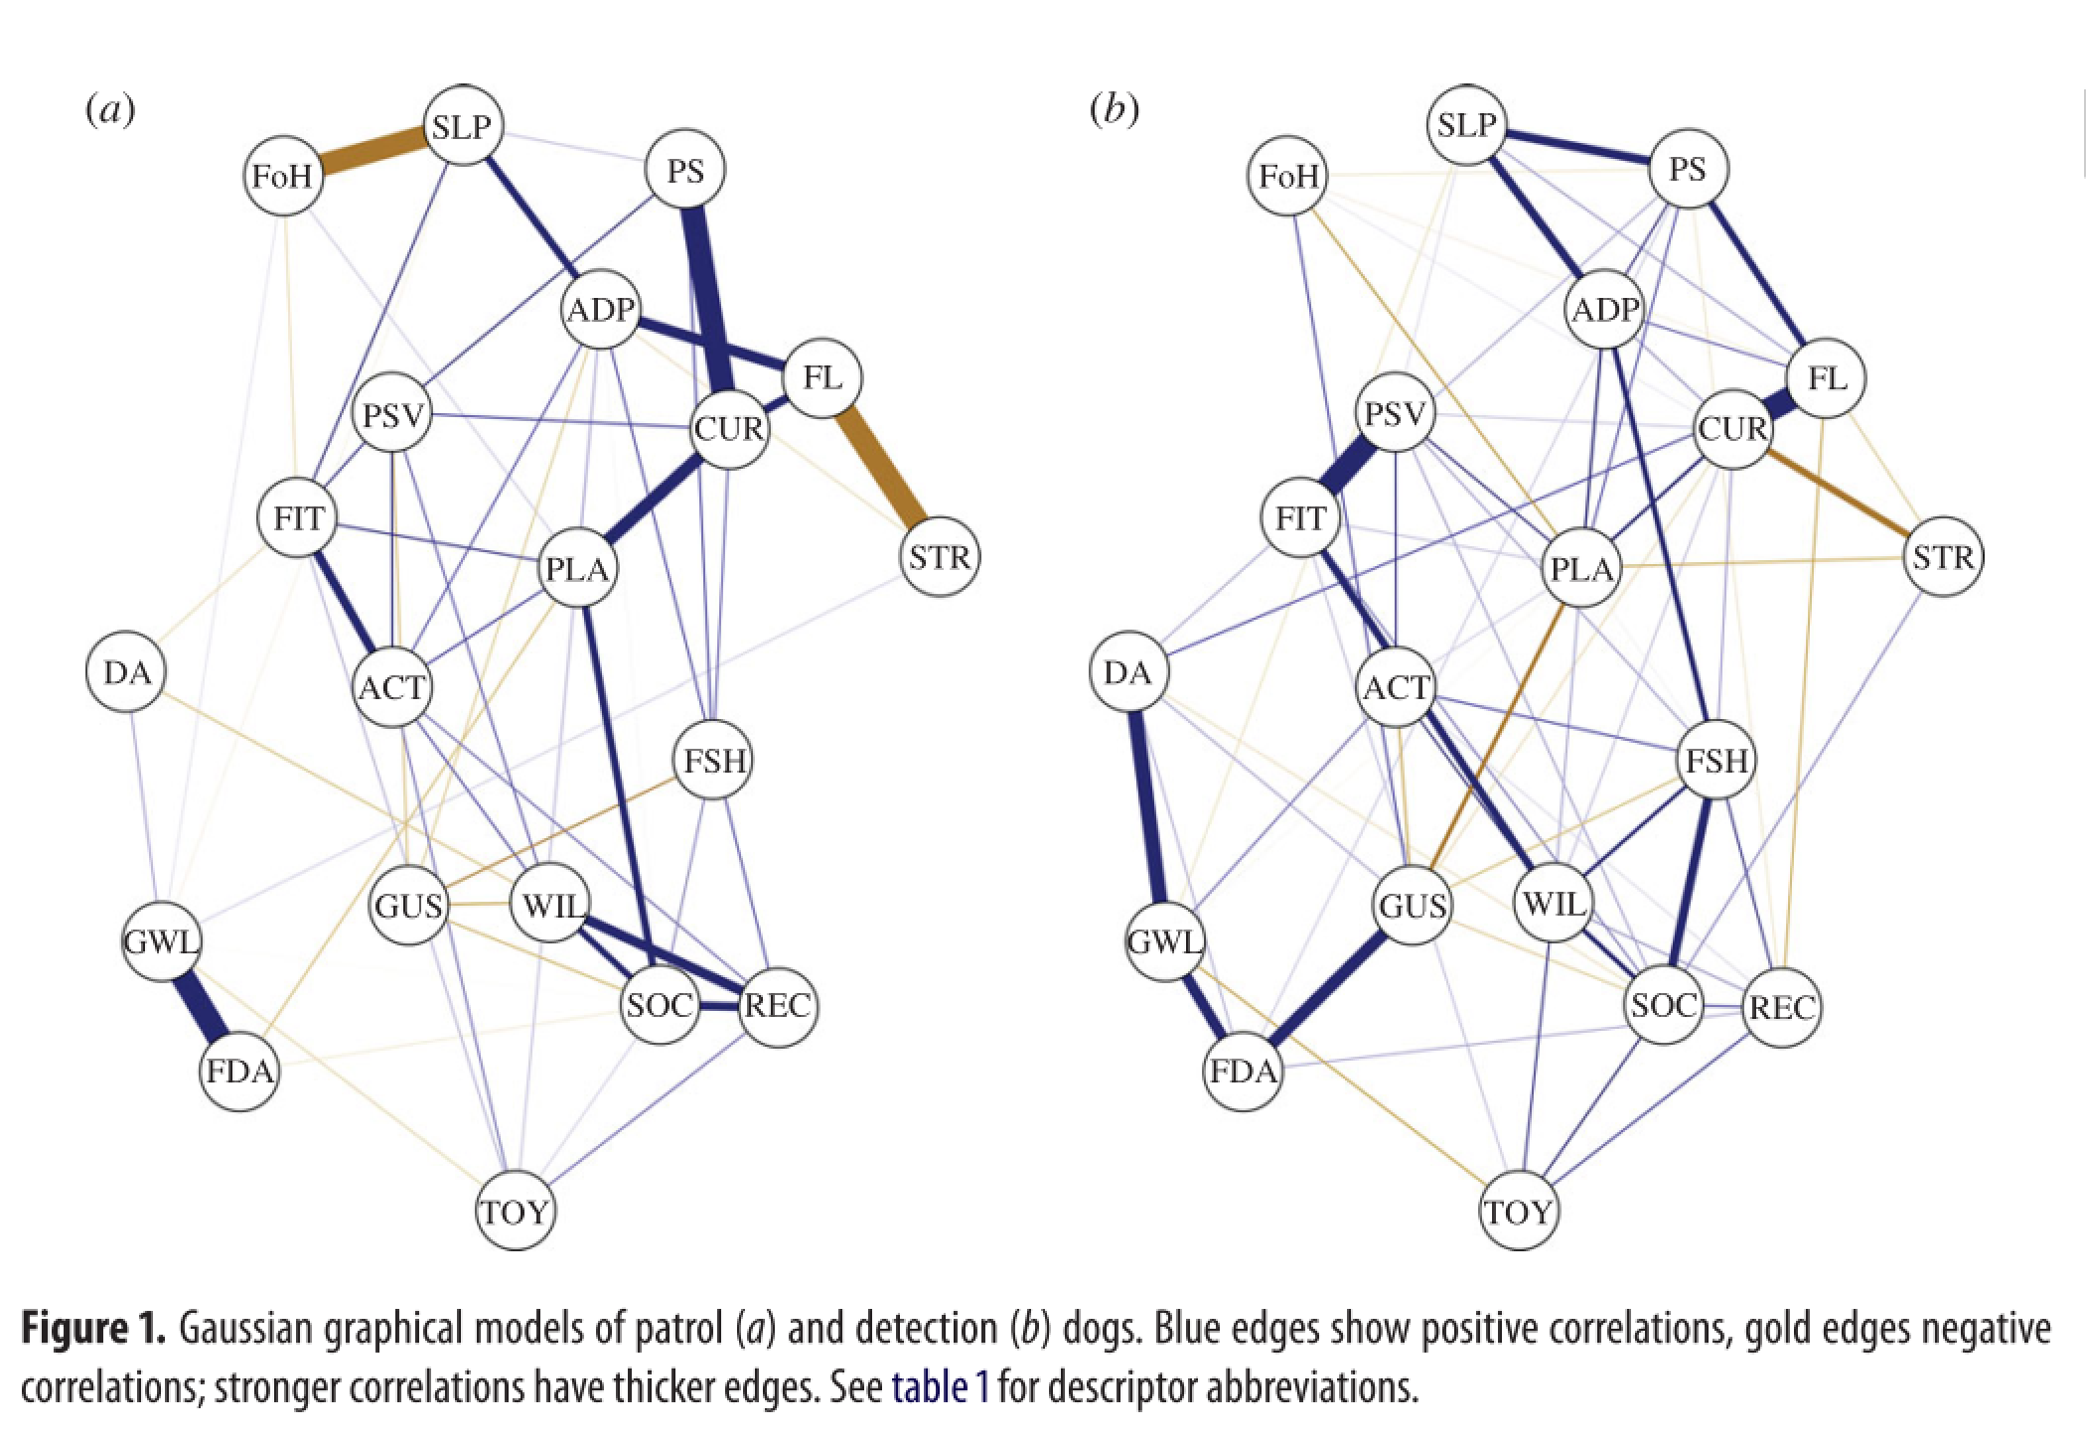

Slide 68

Networks!

Slide 69

Eiko Fried
www.eiko-fried.com
www.psych-networks.com
Twitter @EikoFried
Slides at:
www.eiko-fried.com/VGCT2017
VGCT November 2017

Slide 70

Break

